Slide 1

Employment should only be understood as “Application of Knowledge & Skills” of a Person by Employers to create Value for Society, either through Goods or through Services.
Notes:
Entered text
UNMUKT
Development of critical thinking and conceptual understanding, Higher Secondary School, Classes 11 to 12, Age Group 16 – 18 Years followed by Higher Education and a Career in the Humanities and the Fine Arts.
Employability Factor Score (EFS)-6 is gauged at the end of Class 12, i.e., at age of 18 to find out how far the child is ready to be employed in College for further development of Knowledge and Skills for Higher Education and a Career in the Humanities and the Fine Arts.
EFS-6 is Employability Factor Score based on Learning Outcomes of Competencies envisioned by the National Education Policy (NEP) 2020 as well as Entrance examinations of various Universities and Institutions.
UDYAM
Development of critical thinking and conceptual understanding, Higher Secondary School, Classes 11 to 12, Age Group 16 – 18 Years followed by Higher Education and a Career in Commerce & Social Sciences.
Employability Factor Score (EFS)-6 is gauged at the end of Class 12, i.e., at age of 18 to find out how far the child is ready to be employed in College for further development of Knowledge and Skills for Higher Education and a Career in Commerce & Social Sciences.
EFS-6 is Employability Factor Score based on Learning Outcomes of Competencies envisioned by the National Education Policy (NEP) 2020 as well as Entrance examinations of various Universities and Institutions.
UDAYA
Development of critical thinking and conceptual understanding, Higher Secondary School, Classes 11 to 12, Age Group 16 – 18 Years followed by Higher Education and a Career in Science, Technology, Engineering & Mathematics (STEM).
Employability Factor Score (EFS)-6 is gauged at the end of Class 12, i.e., at age of 18 to find out how far the child is ready to be employed in College for further development of Knowledge and Skills for Higher Education and a Career in Science, Technology, Engineering & Mathematics (STEM).
EFS-6 is Employability Factor Score based on Learning Outcomes of Competencies envisioned by the National Education Policy (NEP) 2020 as well as Entrance examinations of various Universities and Institutions.
Entered text
URJA
Preparing for a career in police, para-military, and defense services requires a unique set of skills, knowledge, and physical fitness. Aspiring candidates need to meet certain eligibility criteria and undergo rigorous training to develop the necessary skills and capabilities.
Assisted preparation for a career in these services can involve several components, including:
Physical fitness training: Physical fitness is a critical aspect of preparing for a career in police, para-military, and defense services. Aspiring candidates need to meet certain physical standards, including strength, endurance, and agility. Assisted preparation can involve providing candidates with training programs that help them build their physical fitness and meet the necessary standards.
Written exam preparation: Candidates for police, para-military, and defense services need to pass a written exam that tests their knowledge of various subjects such as general knowledge, reasoning, mathematics, and current affairs. Assisted preparation can involve providing candidates with study materials, practice tests, and coaching to help them perform well on the exam.
Interview and personality development: After passing the written exam, candidates need to undergo a personal interview, group discussion, and other assessment tests to assess their personality, leadership, communication, and decision-making skills. Assisted preparation can involve providing candidates with coaching and training to develop these skills and perform well in the selection process.
Technical training: Candidates who successfully pass the selection process need to undergo technical training in areas such as weapons handling, tactical maneuvers, first aid, and disaster management. Assisted preparation can involve providing candidates with training programs that help them develop these skills and prepare them for their professional roles.
In summary, assisted preparation for a career in police, para-military, and defense services can involve providing candidates with physical fitness training, written exam preparation, interview and personality development, and technical training. By providing candidates with the necessary training and support, educational institutions and training providers can help aspiring candidates achieve their career goals and serve their country with distinction.
UTKARSH
Grooming individual unique capabilities for vocational training, skill development, and job-oriented certificate level training in various skills is an essential aspect of preparing individuals for successful careers. This involves identifying and nurturing the strengths and interests of individuals and providing them with the training and resources they need to develop their skills and pursue their career goals.
Vocational training programs focus on providing individuals with the specific skills and knowledge they need to succeed in a particular profession or trade. These programs can be customized to meet the needs of different individuals, based on their unique capabilities and career aspirations. By tailoring vocational training programs to the individual needs of learners, educators and trainers can help maximize the effectiveness of these programs.
Skill development programs focus on providing individuals with the general skills and competencies they need to succeed in the workplace, such as communication, problem-solving, and teamwork. These programs can help individuals build their confidence and develop the transferable skills that are valued by employers in a wide range of industries.
Job-oriented certificate level training programs provide individuals with the training and credentials they need to enter specific professions or industries. These programs typically focus on practical, hands-on training that prepares learners for the demands of the workplace. By earning a job-oriented certificate, individuals can demonstrate to employers that they have the specific skills and knowledge needed to succeed in a particular job or industry.
Overall, grooming individual unique capabilities for vocational training, skill development, and job-oriented certificate level training can help individuals maximize their potential and achieve their career goals. By providing learners with the training and resources they need to succeed, educational institutions and training providers can help build a skilled and capable workforce that drives economic growth and development.
UTKRISHT
Entrepreneurial training with legal and financial literacy is an important aspect of preparing individuals for successful careers as entrepreneurs. This type of training provides aspiring entrepreneurs with the knowledge and skills needed to navigate the legal and financial aspects of starting and running a business.
Legal literacy refers to an understanding of the legal framework that governs business activities. This includes knowledge of laws related to business formation, contracts, intellectual property, employment, and taxes. Entrepreneurs who are well-versed in these areas are better equipped to make informed decisions, avoid legal pitfalls, and protect their business interests.
Financial literacy, on the other hand, refers to an understanding of financial management and accounting principles. This includes knowledge of financial statements, budgeting, forecasting, cash flow management, and financial analysis. Entrepreneurs who are financially literate are better equipped to manage their business finances effectively, make informed investment decisions, and secure funding.
Entrepreneurial training programs that incorporate legal and financial literacy can provide aspiring entrepreneurs with the skills and knowledge they need to succeed in today's competitive business environment. These programs can include classroom instruction, case studies, workshops, and mentorship opportunities.
By incorporating legal and financial literacy into entrepreneurial training programs, educational institutions and organizations can help prepare entrepreneurs for the challenges they will face when starting and running a business. This can lead to more successful ventures, job creation, and economic growth in the community.
UDYOG
Alumnus: An alumnus (plural: alumni) refers to a person who has graduated from an educational institution, such as a college or university. Alumni are often viewed as a valuable resource by educational institutions because they can provide support in various forms, such as financial contributions, mentorship, and networking opportunities.
Placement: Placement refers to the process of finding employment for individuals who have completed their education or training. In the context of educational institutions, placement services are often offered to help students secure internships or jobs after graduation.
Entrepreneurship Development Activities: Entrepreneurship development activities refer to initiatives or programs designed to promote and support the growth of entrepreneurial ventures. These activities can include providing training and mentoring to aspiring entrepreneurs, offering access to funding and resources, and organizing networking events.
In the context of educational institutions, entrepreneurship development activities can be an important part of preparing students for successful careers as entrepreneurs or business leaders. By offering resources and support to students interested in starting their own ventures, educational institutions can help foster a culture of innovation and entrepreneurship. Additionally, by connecting students with successful alumni who have started their own businesses, institutions can provide valuable networking opportunities and role models for aspiring entrepreneurs.
Placement services can also be an important aspect of supporting entrepreneurship development. By helping students secure internships or jobs in relevant industries, educational institutions can provide them with valuable experience and connections that can be useful when starting a business. Additionally, by fostering relationships with employers and industry leaders, institutions can help create opportunities for students to connect with potential partners, investors, and customers.
Entered text
I would like to add a few slides to show how we at KEDT have created a mechanism wherein Competency at each level is mapped with competencies at a lower level and it has been done to transmit requirements of the higher level teacher (Real Custometer) to the lower level teacher (Service Provider).
We at Karuna Employability Development Trust believe that Employability can only be improved through a Dynamic Mechanism in society which facilitates real time transmission of requirements of “Value Creators” in terms of “Knowledge & Skills” to “Educators” employing a judicious mix of conceptual and contextual learning tools including and not limited to educational acceleration for students with gifted learning abilities.

Slide 2
93 per cent MBA graduates are unemployable: Problems with management education in India – India Today Web Desk / Roshni Chakrabarty / New Delhi, UPDATED: Feb 6, 2018 15:19 IST
Over 80% Indian engineers are unemployable, lack new-age technology skills – India Today Web Desk / New Delhi, UPDATED: Mar 21, 2019 10:31 IST
Employment should only be understood as “Application of Knowledge & Skills” of a Person
by Employers “to create Value for Society.
Notes:
Entered text
UNMUKT
Development of critical thinking and conceptual understanding, Higher Secondary School, Classes 11 to 12, Age Group 16 – 18 Years followed by Higher Education and a Career in the Humanities and the Fine Arts.
Employability Factor Score (EFS)-6 is gauged at the end of Class 12, i.e., at age of 18 to find out how far the child is ready to be employed in College for further development of Knowledge and Skills for Higher Education and a Career in the Humanities and the Fine Arts.
EFS-6 is Employability Factor Score based on Learning Outcomes of Competencies envisioned by the National Education Policy (NEP) 2020 as well as Entrance examinations of various Universities and Institutions.
UDYAM
Development of critical thinking and conceptual understanding, Higher Secondary School, Classes 11 to 12, Age Group 16 – 18 Years followed by Higher Education and a Career in Commerce & Social Sciences.
Employability Factor Score (EFS)-6 is gauged at the end of Class 12, i.e., at age of 18 to find out how far the child is ready to be employed in College for further development of Knowledge and Skills for Higher Education and a Career in Commerce & Social Sciences.
EFS-6 is Employability Factor Score based on Learning Outcomes of Competencies envisioned by the National Education Policy (NEP) 2020 as well as Entrance examinations of various Universities and Institutions.
UDAYA
Development of critical thinking and conceptual understanding, Higher Secondary School, Classes 11 to 12, Age Group 16 – 18 Years followed by Higher Education and a Career in Science, Technology, Engineering & Mathematics (STEM).
Employability Factor Score (EFS)-6 is gauged at the end of Class 12, i.e., at age of 18 to find out how far the child is ready to be employed in College for further development of Knowledge and Skills for Higher Education and a Career in Science, Technology, Engineering & Mathematics (STEM).
EFS-6 is Employability Factor Score based on Learning Outcomes of Competencies envisioned by the National Education Policy (NEP) 2020 as well as Entrance examinations of various Universities and Institutions.
Entered text
URJA
Preparing for a career in police, para-military, and defense services requires a unique set of skills, knowledge, and physical fitness. Aspiring candidates need to meet certain eligibility criteria and undergo rigorous training to develop the necessary skills and capabilities.
Assisted preparation for a career in these services can involve several components, including:
Physical fitness training: Physical fitness is a critical aspect of preparing for a career in police, para-military, and defense services. Aspiring candidates need to meet certain physical standards, including strength, endurance, and agility. Assisted preparation can involve providing candidates with training programs that help them build their physical fitness and meet the necessary standards.
Written exam preparation: Candidates for police, para-military, and defense services need to pass a written exam that tests their knowledge of various subjects such as general knowledge, reasoning, mathematics, and current affairs. Assisted preparation can involve providing candidates with study materials, practice tests, and coaching to help them perform well on the exam.
Interview and personality development: After passing the written exam, candidates need to undergo a personal interview, group discussion, and other assessment tests to assess their personality, leadership, communication, and decision-making skills. Assisted preparation can involve providing candidates with coaching and training to develop these skills and perform well in the selection process.
Technical training: Candidates who successfully pass the selection process need to undergo technical training in areas such as weapons handling, tactical maneuvers, first aid, and disaster management. Assisted preparation can involve providing candidates with training programs that help them develop these skills and prepare them for their professional roles.
In summary, assisted preparation for a career in police, para-military, and defense services can involve providing candidates with physical fitness training, written exam preparation, interview and personality development, and technical training. By providing candidates with the necessary training and support, educational institutions and training providers can help aspiring candidates achieve their career goals and serve their country with distinction.
UTKARSH
Grooming individual unique capabilities for vocational training, skill development, and job-oriented certificate level training in various skills is an essential aspect of preparing individuals for successful careers. This involves identifying and nurturing the strengths and interests of individuals and providing them with the training and resources they need to develop their skills and pursue their career goals.
Vocational training programs focus on providing individuals with the specific skills and knowledge they need to succeed in a particular profession or trade. These programs can be customized to meet the needs of different individuals, based on their unique capabilities and career aspirations. By tailoring vocational training programs to the individual needs of learners, educators and trainers can help maximize the effectiveness of these programs.
Skill development programs focus on providing individuals with the general skills and competencies they need to succeed in the workplace, such as communication, problem-solving, and teamwork. These programs can help individuals build their confidence and develop the transferable skills that are valued by employers in a wide range of industries.
Job-oriented certificate level training programs provide individuals with the training and credentials they need to enter specific professions or industries. These programs typically focus on practical, hands-on training that prepares learners for the demands of the workplace. By earning a job-oriented certificate, individuals can demonstrate to employers that they have the specific skills and knowledge needed to succeed in a particular job or industry.
Overall, grooming individual unique capabilities for vocational training, skill development, and job-oriented certificate level training can help individuals maximize their potential and achieve their career goals. By providing learners with the training and resources they need to succeed, educational institutions and training providers can help build a skilled and capable workforce that drives economic growth and development.
UTKRISHT
Entrepreneurial training with legal and financial literacy is an important aspect of preparing individuals for successful careers as entrepreneurs. This type of training provides aspiring entrepreneurs with the knowledge and skills needed to navigate the legal and financial aspects of starting and running a business.
Legal literacy refers to an understanding of the legal framework that governs business activities. This includes knowledge of laws related to business formation, contracts, intellectual property, employment, and taxes. Entrepreneurs who are well-versed in these areas are better equipped to make informed decisions, avoid legal pitfalls, and protect their business interests.
Financial literacy, on the other hand, refers to an understanding of financial management and accounting principles. This includes knowledge of financial statements, budgeting, forecasting, cash flow management, and financial analysis. Entrepreneurs who are financially literate are better equipped to manage their business finances effectively, make informed investment decisions, and secure funding.
Entrepreneurial training programs that incorporate legal and financial literacy can provide aspiring entrepreneurs with the skills and knowledge they need to succeed in today's competitive business environment. These programs can include classroom instruction, case studies, workshops, and mentorship opportunities.
By incorporating legal and financial literacy into entrepreneurial training programs, educational institutions and organizations can help prepare entrepreneurs for the challenges they will face when starting and running a business. This can lead to more successful ventures, job creation, and economic growth in the community.
UDYOG
Alumnus: An alumnus (plural: alumni) refers to a person who has graduated from an educational institution, such as a college or university. Alumni are often viewed as a valuable resource by educational institutions because they can provide support in various forms, such as financial contributions, mentorship, and networking opportunities.
Placement: Placement refers to the process of finding employment for individuals who have completed their education or training. In the context of educational institutions, placement services are often offered to help students secure internships or jobs after graduation.
Entrepreneurship Development Activities: Entrepreneurship development activities refer to initiatives or programs designed to promote and support the growth of entrepreneurial ventures. These activities can include providing training and mentoring to aspiring entrepreneurs, offering access to funding and resources, and organizing networking events.
In the context of educational institutions, entrepreneurship development activities can be an important part of preparing students for successful careers as entrepreneurs or business leaders. By offering resources and support to students interested in starting their own ventures, educational institutions can help foster a culture of innovation and entrepreneurship. Additionally, by connecting students with successful alumni who have started their own businesses, institutions can provide valuable networking opportunities and role models for aspiring entrepreneurs.
Placement services can also be an important aspect of supporting entrepreneurship development. By helping students secure internships or jobs in relevant industries, educational institutions can provide them with valuable experience and connections that can be useful when starting a business. Additionally, by fostering relationships with employers and industry leaders, institutions can help create opportunities for students to connect with potential partners, investors, and customers.
Entered text
I would like to add a few slides to show how we at KEDT have created a mechanism wherein Competency at each level is mapped with competencies at a lower level and it has been done to transmit requirements of the higher level teacher (Real Custometer) to the lower level teacher (Service Provider).
We at Karuna Employability Development Trust believe that Employability can only be improved through a Dynamic Mechanism in society which facilitates real time transmission of requirements of “Value Creators” in terms of “Knowledge & Skills” to “Educators” employing a judicious mix of conceptual and contextual learning tools including and not limited to educational acceleration for students with gifted learning abilities.

Slide 3
Only 45% of India’s graduate jobseekers are employable – Business Standard/ Economy News, UPDATED: Sept 30, 2023 17:14 IST
42.3% of graduates under 25 unemployed, finds latest State of Working India report – The Indian Express, New Delhi | Updated: September 21, 2023 07:48 IST
Employment should only be understood as “Application of Knowledge & Skills” of a Person
by Employers “to create Value for Society”.
Notes:
Entered text
UNMUKT
Development of critical thinking and conceptual understanding, Higher Secondary School, Classes 11 to 12, Age Group 16 – 18 Years followed by Higher Education and a Career in the Humanities and the Fine Arts.
Employability Factor Score (EFS)-6 is gauged at the end of Class 12, i.e., at age of 18 to find out how far the child is ready to be employed in College for further development of Knowledge and Skills for Higher Education and a Career in the Humanities and the Fine Arts.
EFS-6 is Employability Factor Score based on Learning Outcomes of Competencies envisioned by the National Education Policy (NEP) 2020 as well as Entrance examinations of various Universities and Institutions.
UDYAM
Development of critical thinking and conceptual understanding, Higher Secondary School, Classes 11 to 12, Age Group 16 – 18 Years followed by Higher Education and a Career in Commerce & Social Sciences.
Employability Factor Score (EFS)-6 is gauged at the end of Class 12, i.e., at age of 18 to find out how far the child is ready to be employed in College for further development of Knowledge and Skills for Higher Education and a Career in Commerce & Social Sciences.
EFS-6 is Employability Factor Score based on Learning Outcomes of Competencies envisioned by the National Education Policy (NEP) 2020 as well as Entrance examinations of various Universities and Institutions.
UDAYA
Development of critical thinking and conceptual understanding, Higher Secondary School, Classes 11 to 12, Age Group 16 – 18 Years followed by Higher Education and a Career in Science, Technology, Engineering & Mathematics (STEM).
Employability Factor Score (EFS)-6 is gauged at the end of Class 12, i.e., at age of 18 to find out how far the child is ready to be employed in College for further development of Knowledge and Skills for Higher Education and a Career in Science, Technology, Engineering & Mathematics (STEM).
EFS-6 is Employability Factor Score based on Learning Outcomes of Competencies envisioned by the National Education Policy (NEP) 2020 as well as Entrance examinations of various Universities and Institutions.
Entered text
URJA
Preparing for a career in police, para-military, and defense services requires a unique set of skills, knowledge, and physical fitness. Aspiring candidates need to meet certain eligibility criteria and undergo rigorous training to develop the necessary skills and capabilities.
Assisted preparation for a career in these services can involve several components, including:
Physical fitness training: Physical fitness is a critical aspect of preparing for a career in police, para-military, and defense services. Aspiring candidates need to meet certain physical standards, including strength, endurance, and agility. Assisted preparation can involve providing candidates with training programs that help them build their physical fitness and meet the necessary standards.
Written exam preparation: Candidates for police, para-military, and defense services need to pass a written exam that tests their knowledge of various subjects such as general knowledge, reasoning, mathematics, and current affairs. Assisted preparation can involve providing candidates with study materials, practice tests, and coaching to help them perform well on the exam.
Interview and personality development: After passing the written exam, candidates need to undergo a personal interview, group discussion, and other assessment tests to assess their personality, leadership, communication, and decision-making skills. Assisted preparation can involve providing candidates with coaching and training to develop these skills and perform well in the selection process.
Technical training: Candidates who successfully pass the selection process need to undergo technical training in areas such as weapons handling, tactical maneuvers, first aid, and disaster management. Assisted preparation can involve providing candidates with training programs that help them develop these skills and prepare them for their professional roles.
In summary, assisted preparation for a career in police, para-military, and defense services can involve providing candidates with physical fitness training, written exam preparation, interview and personality development, and technical training. By providing candidates with the necessary training and support, educational institutions and training providers can help aspiring candidates achieve their career goals and serve their country with distinction.
UTKARSH
Grooming individual unique capabilities for vocational training, skill development, and job-oriented certificate level training in various skills is an essential aspect of preparing individuals for successful careers. This involves identifying and nurturing the strengths and interests of individuals and providing them with the training and resources they need to develop their skills and pursue their career goals.
Vocational training programs focus on providing individuals with the specific skills and knowledge they need to succeed in a particular profession or trade. These programs can be customized to meet the needs of different individuals, based on their unique capabilities and career aspirations. By tailoring vocational training programs to the individual needs of learners, educators and trainers can help maximize the effectiveness of these programs.
Skill development programs focus on providing individuals with the general skills and competencies they need to succeed in the workplace, such as communication, problem-solving, and teamwork. These programs can help individuals build their confidence and develop the transferable skills that are valued by employers in a wide range of industries.
Job-oriented certificate level training programs provide individuals with the training and credentials they need to enter specific professions or industries. These programs typically focus on practical, hands-on training that prepares learners for the demands of the workplace. By earning a job-oriented certificate, individuals can demonstrate to employers that they have the specific skills and knowledge needed to succeed in a particular job or industry.
Overall, grooming individual unique capabilities for vocational training, skill development, and job-oriented certificate level training can help individuals maximize their potential and achieve their career goals. By providing learners with the training and resources they need to succeed, educational institutions and training providers can help build a skilled and capable workforce that drives economic growth and development.
UTKRISHT
Entrepreneurial training with legal and financial literacy is an important aspect of preparing individuals for successful careers as entrepreneurs. This type of training provides aspiring entrepreneurs with the knowledge and skills needed to navigate the legal and financial aspects of starting and running a business.
Legal literacy refers to an understanding of the legal framework that governs business activities. This includes knowledge of laws related to business formation, contracts, intellectual property, employment, and taxes. Entrepreneurs who are well-versed in these areas are better equipped to make informed decisions, avoid legal pitfalls, and protect their business interests.
Financial literacy, on the other hand, refers to an understanding of financial management and accounting principles. This includes knowledge of financial statements, budgeting, forecasting, cash flow management, and financial analysis. Entrepreneurs who are financially literate are better equipped to manage their business finances effectively, make informed investment decisions, and secure funding.
Entrepreneurial training programs that incorporate legal and financial literacy can provide aspiring entrepreneurs with the skills and knowledge they need to succeed in today's competitive business environment. These programs can include classroom instruction, case studies, workshops, and mentorship opportunities.
By incorporating legal and financial literacy into entrepreneurial training programs, educational institutions and organizations can help prepare entrepreneurs for the challenges they will face when starting and running a business. This can lead to more successful ventures, job creation, and economic growth in the community.
UDYOG
Alumnus: An alumnus (plural: alumni) refers to a person who has graduated from an educational institution, such as a college or university. Alumni are often viewed as a valuable resource by educational institutions because they can provide support in various forms, such as financial contributions, mentorship, and networking opportunities.
Placement: Placement refers to the process of finding employment for individuals who have completed their education or training. In the context of educational institutions, placement services are often offered to help students secure internships or jobs after graduation.
Entrepreneurship Development Activities: Entrepreneurship development activities refer to initiatives or programs designed to promote and support the growth of entrepreneurial ventures. These activities can include providing training and mentoring to aspiring entrepreneurs, offering access to funding and resources, and organizing networking events.
In the context of educational institutions, entrepreneurship development activities can be an important part of preparing students for successful careers as entrepreneurs or business leaders. By offering resources and support to students interested in starting their own ventures, educational institutions can help foster a culture of innovation and entrepreneurship. Additionally, by connecting students with successful alumni who have started their own businesses, institutions can provide valuable networking opportunities and role models for aspiring entrepreneurs.
Placement services can also be an important aspect of supporting entrepreneurship development. By helping students secure internships or jobs in relevant industries, educational institutions can provide them with valuable experience and connections that can be useful when starting a business. Additionally, by fostering relationships with employers and industry leaders, institutions can help create opportunities for students to connect with potential partners, investors, and customers.
Entered text
I would like to add a few slides to show how we at KEDT have created a mechanism wherein Competency at each level is mapped with competencies at a lower level and it has been done to transmit requirements of the higher level teacher (Real Custometer) to the lower level teacher (Service Provider).
We at Karuna Employability Development Trust believe that Employability can only be improved through a Dynamic Mechanism in society which facilitates real time transmission of requirements of “Value Creators” in terms of “Knowledge & Skills” to “Educators” employing a judicious mix of conceptual and contextual learning tools including and not limited to educational acceleration for students with gifted learning abilities.

Slide 4
Worthless degrees are creating an unemployable generation in India - Business Standard / India News UPDATED: April 18, 2023 7:00 IST
Survey reveals 33% educated youth are unemployed due to lack of future skills - India Today Web Desk / New Delhi, UPDATED: Sept 18, 2021 17:18 IST
Employment should only be understood as “Application of Knowledge & Skills” of a Person
by Employers “to create Value for Society”.
Notes:
UNMUKT
Development of critical thinking and conceptual understanding, Higher Secondary School, Classes 11 to 12, Age Group 16 – 18 Years followed by Higher Education and a Career in the Humanities and the Fine Arts.
Employability Factor Score (EFS)-6 is gauged at the end of Class 12, i.e., at age of 18 to find out how far the child is ready to be employed in College for further development of Knowledge and Skills for Higher Education and a Career in the Humanities and the Fine Arts.
EFS-6 is Employability Factor Score based on Learning Outcomes of Competencies envisioned by the National Education Policy (NEP) 2020 as well as Entrance examinations of various Universities and Institutions.
UDYAM
Development of critical thinking and conceptual understanding, Higher Secondary School, Classes 11 to 12, Age Group 16 – 18 Years followed by Higher Education and a Career in Commerce & Social Sciences.
Employability Factor Score (EFS)-6 is gauged at the end of Class 12, i.e., at age of 18 to find out how far the child is ready to be employed in College for further development of Knowledge and Skills for Higher Education and a Career in Commerce & Social Sciences.
EFS-6 is Employability Factor Score based on Learning Outcomes of Competencies envisioned by the National Education Policy (NEP) 2020 as well as Entrance examinations of various Universities and Institutions.
UDAYA
Development of critical thinking and conceptual understanding, Higher Secondary School, Classes 11 to 12, Age Group 16 – 18 Years followed by Higher Education and a Career in Science, Technology, Engineering & Mathematics (STEM).
Employability Factor Score (EFS)-6 is gauged at the end of Class 12, i.e., at age of 18 to find out how far the child is ready to be employed in College for further development of Knowledge and Skills for Higher Education and a Career in Science, Technology, Engineering & Mathematics (STEM).
EFS-6 is Employability Factor Score based on Learning Outcomes of Competencies envisioned by the National Education Policy (NEP) 2020 as well as Entrance examinations of various Universities and Institutions.
Entered text
URJA
Preparing for a career in police, para-military, and defense services requires a unique set of skills, knowledge, and physical fitness. Aspiring candidates need to meet certain eligibility criteria and undergo rigorous training to develop the necessary skills and capabilities.
Assisted preparation for a career in these services can involve several components, including:
Physical fitness training: Physical fitness is a critical aspect of preparing for a career in police, para-military, and defense services. Aspiring candidates need to meet certain physical standards, including strength, endurance, and agility. Assisted preparation can involve providing candidates with training programs that help them build their physical fitness and meet the necessary standards.
Written exam preparation: Candidates for police, para-military, and defense services need to pass a written exam that tests their knowledge of various subjects such as general knowledge, reasoning, mathematics, and current affairs. Assisted preparation can involve providing candidates with study materials, practice tests, and coaching to help them perform well on the exam.
Interview and personality development: After passing the written exam, candidates need to undergo a personal interview, group discussion, and other assessment tests to assess their personality, leadership, communication, and decision-making skills. Assisted preparation can involve providing candidates with coaching and training to develop these skills and perform well in the selection process.
Technical training: Candidates who successfully pass the selection process need to undergo technical training in areas such as weapons handling, tactical maneuvers, first aid, and disaster management. Assisted preparation can involve providing candidates with training programs that help them develop these skills and prepare them for their professional roles.
In summary, assisted preparation for a career in police, para-military, and defense services can involve providing candidates with physical fitness training, written exam preparation, interview and personality development, and technical training. By providing candidates with the necessary training and support, educational institutions and training providers can help aspiring candidates achieve their career goals and serve their country with distinction.
UTKARSH
Grooming individual unique capabilities for vocational training, skill development, and job-oriented certificate level training in various skills is an essential aspect of preparing individuals for successful careers. This involves identifying and nurturing the strengths and interests of individuals and providing them with the training and resources they need to develop their skills and pursue their career goals.
Vocational training programs focus on providing individuals with the specific skills and knowledge they need to succeed in a particular profession or trade. These programs can be customized to meet the needs of different individuals, based on their unique capabilities and career aspirations. By tailoring vocational training programs to the individual needs of learners, educators and trainers can help maximize the effectiveness of these programs.
Skill development programs focus on providing individuals with the general skills and competencies they need to succeed in the workplace, such as communication, problem-solving, and teamwork. These programs can help individuals build their confidence and develop the transferable skills that are valued by employers in a wide range of industries.
Job-oriented certificate level training programs provide individuals with the training and credentials they need to enter specific professions or industries. These programs typically focus on practical, hands-on training that prepares learners for the demands of the workplace. By earning a job-oriented certificate, individuals can demonstrate to employers that they have the specific skills and knowledge needed to succeed in a particular job or industry.
Overall, grooming individual unique capabilities for vocational training, skill development, and job-oriented certificate level training can help individuals maximize their potential and achieve their career goals. By providing learners with the training and resources they need to succeed, educational institutions and training providers can help build a skilled and capable workforce that drives economic growth and development.
UTKRISHT
Entrepreneurial training with legal and financial literacy is an important aspect of preparing individuals for successful careers as entrepreneurs. This type of training provides aspiring entrepreneurs with the knowledge and skills needed to navigate the legal and financial aspects of starting and running a business.
Legal literacy refers to an understanding of the legal framework that governs business activities. This includes knowledge of laws related to business formation, contracts, intellectual property, employment, and taxes. Entrepreneurs who are well-versed in these areas are better equipped to make informed decisions, avoid legal pitfalls, and protect their business interests.
Financial literacy, on the other hand, refers to an understanding of financial management and accounting principles. This includes knowledge of financial statements, budgeting, forecasting, cash flow management, and financial analysis. Entrepreneurs who are financially literate are better equipped to manage their business finances effectively, make informed investment decisions, and secure funding.
Entrepreneurial training programs that incorporate legal and financial literacy can provide aspiring entrepreneurs with the skills and knowledge they need to succeed in today's competitive business environment. These programs can include classroom instruction, case studies, workshops, and mentorship opportunities.
By incorporating legal and financial literacy into entrepreneurial training programs, educational institutions and organizations can help prepare entrepreneurs for the challenges they will face when starting and running a business. This can lead to more successful ventures, job creation, and economic growth in the community.
UDYOG
Alumnus: An alumnus (plural: alumni) refers to a person who has graduated from an educational institution, such as a college or university. Alumni are often viewed as a valuable resource by educational institutions because they can provide support in various forms, such as financial contributions, mentorship, and networking opportunities.
Placement: Placement refers to the process of finding employment for individuals who have completed their education or training. In the context of educational institutions, placement services are often offered to help students secure internships or jobs after graduation.
Entrepreneurship Development Activities: Entrepreneurship development activities refer to initiatives or programs designed to promote and support the growth of entrepreneurial ventures. These activities can include providing training and mentoring to aspiring entrepreneurs, offering access to funding and resources, and organizing networking events.
In the context of educational institutions, entrepreneurship development activities can be an important part of preparing students for successful careers as entrepreneurs or business leaders. By offering resources and support to students interested in starting their own ventures, educational institutions can help foster a culture of innovation and entrepreneurship. Additionally, by connecting students with successful alumni who have started their own businesses, institutions can provide valuable networking opportunities and role models for aspiring entrepreneurs.
Placement services can also be an important aspect of supporting entrepreneurship development. By helping students secure internships or jobs in relevant industries, educational institutions can provide them with valuable experience and connections that can be useful when starting a business. Additionally, by fostering relationships with employers and industry leaders, institutions can help create opportunities for students to connect with potential partners, investors, and customers.
Entered text
I would like to add a few slides to show how we at KEDT have created a mechanism wherein Competency at each level is mapped with competencies at a lower level and it has been done to transmit requirements of the higher level teacher (Real Custometer) to the lower level teacher (Service Provider).
We at Karuna Employability Development Trust believe that Employability can only be improved through a Dynamic Mechanism in society which facilitates real time transmission of requirements of “Value Creators” in terms of “Knowledge & Skills” to “Educators” employing a judicious mix of conceptual and contextual learning tools including and not limited to educational acceleration for students with gifted learning abilities.

Slide 5
Is unemployment a result of
Lack of Jobs ?
Or
Lack of Employability ?
Employment should only be understood as “Application of Knowledge & Skills” of a Person
by Employers “to create Value for Society”.

Slide 6



Employment is not “of a person, in a job”;
Competency Requirement
Job is available but we need Employability
I need a job
Services
Q.C
Services
Job Seeker
Employers
Certificate = Education ?
Q.C : Quality Control ensures that the service is the requirement of the consumer / service receiver to the service provider.
Employment should only be understood as “Application of Knowledge & Skills” of a Person
by Employers “to create Value for Society”.

Slide 7



Industrial Assembly Line
Supplier
Manufacturer
Customer
Transmission of Requirement
Transmission of Requirement
Components/ Services
Goods /
Services
Q.C
Q.C
Employment should only be understood as “Application of Knowledge & Skills” of a Person
by Employers “to create Value for Society”.

Slide 8

4. ECONOMIC PARTICIPATION
Employment should only be understood as “Application of Knowledge & Skills” of a Person
by Employers “to create Value for Society”.

Slide 9
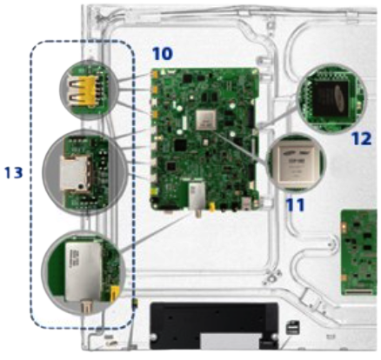
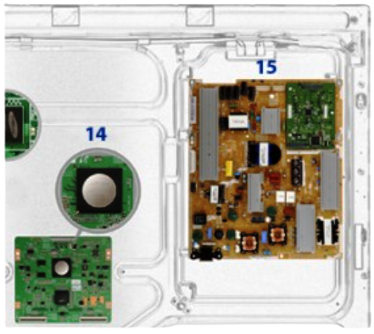




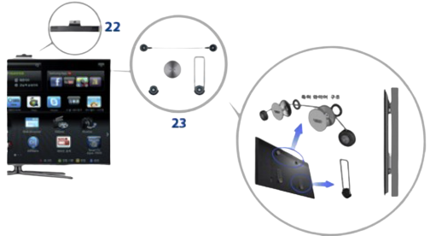
Smart TV: 24 sub-assemblies
24
If we break down the sub-assemblies, then perhaps we will have 2500 individual pieces or more
Employment should only be understood as “Application of Knowledge & Skills” of a Person
by Employers “to create Value for Society”.

Slide 10
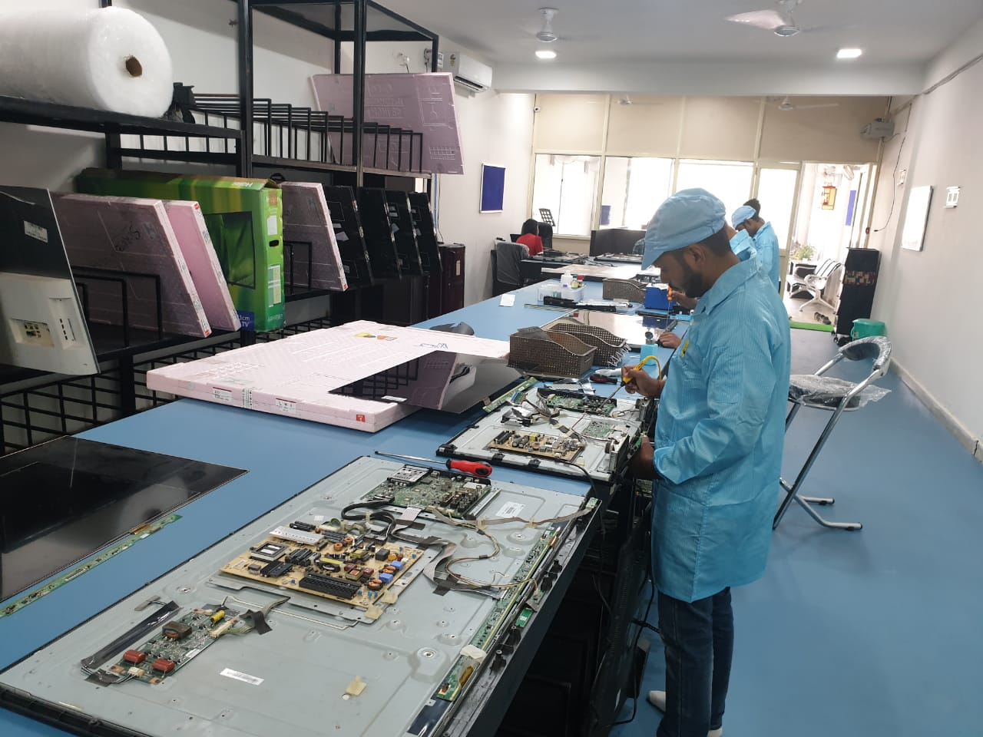
Employment should only be understood as “Application of Knowledge & Skills” of a Person
by Employers “to create Value for Society”.

Slide 11


Education Assembly Line
School
Competency Requirement
Higher Education
Competency Requirement
Employer
Evaluation
Recruitment
Q.C
Q.C
Employment should only be understood as “Application of Knowledge & Skills” of a Person
by Employers “to create Value for Society”.

Slide 12



Competency Requirement
Recruitment Process
Selection
Q.C
Higher Education
Employer
Rejection
Employment should only be understood as “Application of Knowledge & Skills” of a Person
by Employers “to create Value for Society”.

Slide 13

Employer
Higher Education
School
EVALUATION QC
EVALUATION QC
Employment should only be understood as “Application of Knowledge & Skills” of a Person
by Employers “to create Value for Society”.

Slide 14
Employer
Comp. Requirements
Higher Education
Comp. Requirements
Higher Secondary
EVALUATION QC
Comp. Requirements
Secondary
EVALUATION QC
Comp. Requirements
Middle
EVALUATION QC
Comp. Requirements
EVALUATION QC
Primary
Comp. Requirements
Foundational
EVALUATION QC
Comp. Requirements
ECCE
EVALUATION QC
EVALUATION QC
Employment should only be understood as “Application of Knowledge & Skills” of a Person
by Employers “to create Value for Society”.

Slide 15
How do we propose to transmit the competency requirement of a higher segment to lower segment?
Employment should only be understood as “Application of Knowledge & Skills” of a Person
by Employers “to create Value for Society”.

Slide 16
We propose to use the competency framework system given to us by NCF School Education-2023 (NCF-FS, NCF-PS, etc.) which has been framed under NEP-2020
Employment should only be understood as “Application of Knowledge & Skills” of a Person
by Employers “to create Value for Society”.

Slide 17

I am Sweeta
I teach Science at Grade II
Employment should only be understood as “Application of Knowledge & Skills” of a Person
by Employers “to create Value for Society”.

Slide 18

I am Priyanka
I teach science at Grade III
I am Sweeta
I Teach science at Grade II
Employment should only be understood as “Application of Knowledge & Skills” of a Person
by Employers “to create Value for Society”.

Slide 19
Who am I teaching for?
Employment should only be understood as “Application of Knowledge & Skills” of a Person
by Employers “to create Value for Society”.

Slide 20
Am I teaching for
Student - ?
Parents - ?
Government -?
Society - ?
Employment should only be understood as “Application of Knowledge & Skills” of a Person
by Employers “to create Value for Society”.

Slide 21
Student - Immediate Customer
Parents - Immediate Customer
Government - Immediate Customer
Society - Ultimate Customer
Employment should only be understood as “Application of Knowledge & Skills” of a Person
by Employers “to create Value for Society”.

Slide 22
Who is my Real Customer or Service Receiver?
Employment should only be understood as “Application of Knowledge & Skills” of a Person
by Employers “to create Value for Society”.

Slide 23
My real service receiver is Priyanka, who is teaching science at Grade III.
Actually I am preparing students of Grade II for her.
As a service receiver my job is to add value and further prepare students for Grade IV as per the requirements of the Grade IV teacher.
Employment should only be understood as “Application of Knowledge & Skills” of a Person
by Employers “to create Value for Society”.

Slide 24
Employer
Comp. Requirements
Higher Education
Comp. Requirements
Higher Secondary
EVALUATION QC
Comp. Requirements
Secondary
EVALUATION QC
Comp. Requirements
Middle
EVALUATION QC
Comp. Requirements
EVALUATION QC
Primary
Comp. Requirements
Foundational
EVALUATION QC
Comp. Requirements
ECCE
EVALUATION QC
EVALUATION QC
Employment should only be understood as “Application of Knowledge & Skills” of a Person
by Employers “to create Value for Society”.

Slide 25



KEDT Segmentation as per NEP 2020
UTPATTI: Early Childhood Care and Education (ECCE), Age Group: 0-3 Year.
ECCE Stage
UDYAN: Fundamental Literacy and numeracy, Age Group: 3-6 Year at Play School
Foundation Stage
UDVEG: Fundamental Literacy and numeracy, Age Group: 6-8 Year at Class 1 & Class 2.
Employment should only be understood as “Application of Knowledge & Skills” of a Person
by Employers “to create Value for Society”.

Slide 26



KEDT Segmentation as per NEP 2020
Primary Stage
UTTHAN: Identification and Self Awareness of individual unique capabilities, preparatory school, Age Group: 8-11 Years, Class 3-5.
Middle Stage
ULLAS: Development of individual unique capabilities & digital literacy, Age Group: 11-14 Years, Middle school, Class 6-8.
URDHVAM: Development of Critical thinking and conceptual understanding, Age Group: 14-16 Years, Class 9-10.
Secondary Stage
Employment should only be understood as “Application of Knowledge & Skills” of a Person
by Employers “to create Value for Society”.

Slide 27





KEDT Segmentation as per NEP 2020
UNMUKT: Development of Critical thinking and conceptual understanding, Age Group: 16-18 Years, Class 11-12 followed by Higher Education and a career in humanities and fine art.
UDYAM: Development of Critical thinking and conceptual understanding, Age Group: 16-18 Years, Class 11-12 followed by Higher Education and a career in Commerce & Social Science .
UDAYA: Development of Critical thinking and conceptual understanding, Age Group: 16-18 Years, Class 11-12 followed by Higher Education and a career in Science, Technology, Engineering & Mathematics (STEM).
Higher Secondary Stage
UTKARSH: Grooming of individual unique capabilities for Vocational Training & Job oriented certificate level training in vocational skills.
URJA: Assisted preparation for career in various Police, Para Military & Defense Services.
Employment should only be understood as “Application of Knowledge & Skills” of a Person
by Employers “to create Value for Society”.

Slide 28
ECONOMIC PARTICIPATION
One of the aims of National Curriculum Framework for School Education (NEP 2020)
Employment should only be understood as “Application of Knowledge & Skills” of a Person
by Employers “to create Value for Society”.

Slide 29
National Curriculum Framework 2023 (NEP 2020)
Domains
D-1
Curricular Goals
D-2
CG-1
Competencies
D-3
CG-2
CG1C1
Learning Outcomes
D-4
CG-3
CG1C2
CG1C1LO1
D-5
CG-4
CG1C3
CG1C1LO2
D-6
CG-5
CG1C4
CG1C1LO3
Employment should only be understood as “Application of Knowledge & Skills” of a Person
by Employers “to create Value for Society”.

Slide 30
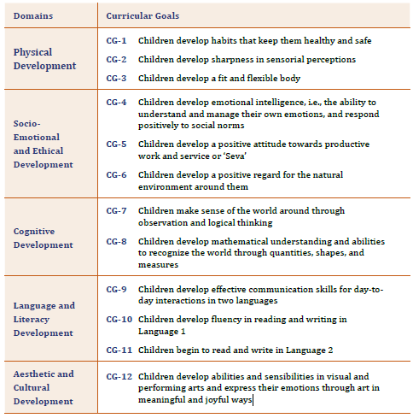
Employment should only be understood as “Application of Knowledge & Skills” of a Person
by Employers “to create Value for Society”.

Slide 31
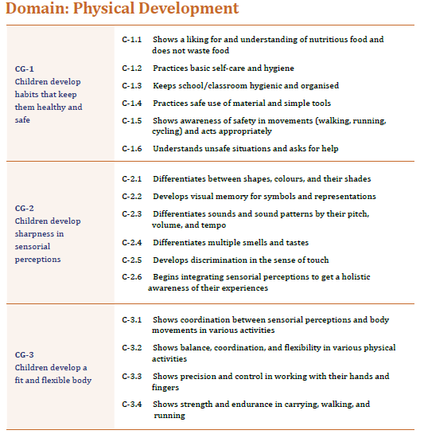
Employment should only be understood as “Application of Knowledge & Skills” of a Person
by Employers “to create Value for Society”.

Slide 32
Foundational literacy and numeracy, age group of 6-8 years at Class 1 & Class 2
Foundational literacy and numeracy, age group of 3 - 6 years at Play School
DOMAIN | Language and Literacy Development
CURRICULAR GOAL | Children develop effective communication skill for day to day interaction in two languages.
COMPETENCY | Converses Fluently and can hold a meaningful Conversation.
LEARNING OUTCOME
1. Maintains the thread of the conversation across multiple exchanges. 2. Engage in discussion about a topic and raise and respond to questions.
DOMAIN | Language and Literacy Development
CURRICULAR GOAL | Children develop effective communication skill for day to day interaction in two languages.
COMPETENCY | Converses Fluently and can hold a meaningful Conversation.
LEARNING OUTCOME
Initiates conversations in daily life with peers and teachers in a verity of school settings. Narrates daily experiences in simple sentences and ask simple questions.
LO Mapping
Employment should only be understood as “Application of Knowledge & Skills” of a Person
by Employers “to create Value for Society”.

Slide 33
KEDT MECHANISM
KEDT Facilitates real time transmission of requirements of “Value Creators” in terms of “Knowledge & Skills” to “Educators”, including and not limited to educational acceleration for students with gifted learning abilities, through it’s innovative Competency Framework Mapping System called K-CFMS.
Employment should only be understood as “Application of Knowledge & Skills” of a Person
by Employers “to create Value for Society”.

Slide 34

K-CFMS TM (Karuna Competency Framework Mapping System)
K-CFMS; [J = (L^{p}_{1…n} + A^{p}_{1…n} + S^{p}_{1…n})];
Where,
J = Job Competency as a function of
L = Language Competencies,
A = Academic Competencies and
S = Skill Competencies at Proficiency Levels of
p (1, 2 or 3).
TM
Employment should only be understood as “Application of Knowledge & Skills” of a Person
by Employers “to create Value for Society”.

Slide 35
What is KEFT ?
Karuna Employability Factor Test (KEFT):
KEFT is a Cloud based CBT exam empowered by AI enabled Predictive Analytics, conducted at regular intervals.
It is designed under the supervision of a Panel of experts including Employers and Educators (from higher segments) who ensure that Job Competency requirements transmitted through K-CFMS are properly translated by Educators into learners.
EFS is the result of KEFT.
Employment should only be understood as “Application of Knowledge & Skills” of a Person
by Employers “to create Value for Society”.

Slide 36
What Is EFS ?
Employability Factor Score (EFS) is gauged at the end of one segment to find out how far the student is ready to be employed in a higher segment for further value addition.
Employment should only be understood as “Application of Knowledge & Skills” of a Person
by Employers “to create Value for Society”.

Slide 37
Learning Tools Administration
Administration of learning tools through an Andragogical approach supported by Pedagogical methods in schools targeted at specific Learning Outcomes.
K-CFMS keeps track of the duration of engagement of a student in any particular Learning Tool during a Quarter in order to gauge the effectiveness of each Learning Tool in achieving targeted Learning Outcomes.
Employment should only be understood as “Application of Knowledge & Skills” of a Person
by Employers “to create Value for Society”.

Slide 38
KEDT Journey So Far (From 17/11/2022 to 10/10/2023)
No of Projects: 56
No of Members: 665
No of Beneficiaries: 502
Project ID | Name of Project | Location | Benificiary Members | Mentors & Educators
Project 5 | SBG-GURUKUL-UTTHAN (2023-24) | Khandagiri,Bhubaneswar | 16 | 4
Project 6 | SBG-GURUKUL-ULLAS (2023-24) | Khandagiri,Bhubaneswar | 13 | 6
Project 7 | SBG-GURUKUL-UNMUKT (2023-24) | Khandagiri,Bhubaneswar | 11 | 6
Project 8 | ABASIKA SARASWATI SHISHU MANDIR-ULLAS-2023-24 | Kalinga Vihar,Sum Hospital BBSR | 25 | 6
Project 9 | ABASIKA SARASWATI SHISHU MANDIR-UTTHAN-2023-24 | Kalinga Vihar,Sum Hospital BBSR | 6 | 3
Project 10 | ABASIKA SARASWATI SHISHU MANDIR-UNMUKT-2023-24 | Kalinga Vihar,Sum Hospital BBSR | 25 | 6
Project 11 | ADRUTA CHILDREN HOME - DHENKANAL - UDVEG - 2023-24 | College chowk,Dhenkanal | 4 | 2
Project 12 | ADRUTA CHILDREN HOME - DHENKANAL - UTTHAN - 2023-24 | College chowk,Dhenkanal | 1 | 2
Project 13 | ADRUTA CHILDREN HOME - DHENKANAL - ULLAS - 2023-24 | College chowk,Dhenkanal | 25 | 5
Project 14 | ADRUTA CHILDREN HOME - DHENKANAL - UDAYA - 2023-24 | College chowk,Dhenkanal | 8 | 4
Project 15 | ALLEN BHUBANESWAR PATIA CENTRE - UDAYA - 2023-24 | Patia,BBSR | 1 | 2
Project 16 | ADRUTA CHILDREN HOME (BOYS) - BHUBANESWAR - UDVEG - 2023-24 | Kantabada,BBSR | 6 | 2
Project 17 | ADRUTA CHILDREN HOME (BOYS) - BHUBANESWAR - UTTHAN - 2023-24 | Kantabada,BBSR | 6 | 2
Project 18 | ADRUTA CHILDREN HOME (BOYS) - BHUBANESWAR - ULLAS - 2023-24 | Kantabada,BBSR | 13 | 5
Project 19 | ADRUTA CHILDREN HOME (BOYS) - BHUBANESWAR - UTKARSH - 2023-24 | Kantabada,BBSR | 3 | 2
Project 20 | ADRUTA CHILDREN HOME (BOYS) - BHUBANESWAR - UDAYA- 2023-24 | Kantabada,BBSR | 1 | 2
Project 21 | ADRUTA CHILDREN HOME (BOYS) - BHUBANESWAR - UNMUKT-2023-24 | Kantabada,BBSR | 3 | 2
Employment should only be understood as “Application of Knowledge & Skills” of a Person
by Employers “to create Value for Society”.

Slide 39
KEDT Journey So Far (From 17/11/2022 to 10/10/2023)
Project ID | Name of Project | Location | Benificiary Members | Mentors & Educators
Project 22 | ADRUTA CHILDREN HOME(GIRLS)-BHUBANESWAR-UTTHAN-2023-24 | Mendhasala,BBSR | 2 | 2
Project 23 | ADRUTA CHILDREN HOME(GIRLS)-BHUBANESWAR-ULLAS-2023-24 | Mendhasala,BBSR | 11 | 3
Project 24 | ADRUTA CHILDREN HOME(GIRLS)-BHUBANESWAR-UDAYA-2023-24 | Mendhasala,BBSR | 38 | 5
Project 25 | ADRUTA CHILDREN HOME(GIRLS)-BHUBANESWAR-UTKARSH-2023-24 | Mendhasala,BBSR | 11 | 3
Project 26 | ADRUTA CHILDREN HOME(GIRLS)-BHUBANESWAR-UNMUKT-2023-24 | Mendhasala,BBSR | 23 | 5
Project 27 | ADRUTA CHILDREN HOME-MAYURBHANJ-UDVEG-2023-24 | Debendrapur,Mayurbhanj | 5 | 2
Project 28 | ADRUTA CHILDREN HOME-MAYURBHANJ-UTTHAN-2023-24 | Debendrapur,Mayurbhanj | 12 | 3
Project 29 | ADRUTA CHILDREN HOME-MAYURBHANJ-ULLAS-2023-24 | Debendrapur,Mayurbhanj | 7 | 3
Project 30 | ADRUTA CHILDREN HOME-MAYURBHANJ-UDAYA-2023-24 | Debendrapur,Mayurbhanj | 14 | 4
Project 31 | ADRUTA CHILDREN HOME-MAYURBHANJ-UTKARSH-2023-24 | Debendrapur,Mayurbhanj | 1 | 2
Project 32 | ADRUTA CHILDREN HOME - PURI - UTKARSH 2023-24 | Baligauli Puri | 2 | 2
Project 33 | ADRUTA CHILDREN HOME - PURI - UDAYA 2023-24 | Baligauli Puri | 8 | 3
Project 34 | ADRUTA CHILDREN HOME - PURI - UTTHAN 2023-24 | Baligauli Puri | 3 | 2
Project 35 | ADRUTA CHILDREN HOME - PURI - ULLAS 2023-24 | Baligauli Puri | 11 | 3
Project 36 | ADRUTA CHILDREN HOME(BOYS)-SUNDERGARH-UTKARSH-2023-24 | Subalaya,Sundergarh | 5 | 2
Project 37 | ADRUTA CHILDREN HOME(BOYS)-SUNDERGARH-UDVEG-2023-24 | Subalaya,Sundergarh | 2 | 2
Project 38 | ADRUTA CHILDREN HOME(BOYS)-SUNDERGARH-UDAYA-2023-24 | Subalaya,Sundergarh | 6 | 2
Project 39 | ADRUTA CHILDREN HOME(BOYS)-SUNDERGARH-ULLAS-2023-24 | Subalaya,Sundergarh | 5 | 2
Project 40 | ADRUTA CHILDREN HOME(BOYS)-SUNDERGARH-UTTHAN-2023-24 | Subalaya,Sundergarh | 6 | 2
Employment should only be understood as “Application of Knowledge & Skills” of a Person
by Employers “to create Value for Society”.

Slide 40
KEDT Journey So Far (From 17/11/2022 to 10/10/2023)
Project ID | Name of Project | Location | Beneficiary Members | Mentors & Educators
Project 41 | ADRUTA CHILDREN HOME (GIRLS) - CUTTACK - UDAYA - 2023-24 | Tulasipur,Cuttack | 8 | 2
Project 42 | ADRUTA CHILDREN HOME (GIRLS) - CUTTACK - UTTHAN - 2023-24 | Tulasipur,Cuttack | 7 | 2
Project 43 | ADRUTA CHILDREN HOME (GIRLS) - CUTTACK - ULLAS - 2023-24 | Tulasipur,Cuttack | 10 | 3
Project 44 | ADRUTA CHILDREN HOME (GIRLS) - CUTTACK - UDVEG - 2023-24 | Tulasipur,Cuttack | 1 | 2
Project 45 | ADRUTA CHILDREN HOME(GIRLS)-ANGUL-UTTHAN-2023-24 | Panchamahal,Angul | 9 | 3
Project 46 | ADRUTA CHILDREN HOME(GIRLS)-ANGUL-UDVEG-2023-24 | Panchamahal,Angul | 6 | 2
Project 47 | ADRUTA CHILDREN HOME(GIRLS)-ANGUL-ULLAS-2023-24 | Panchamahal,Angul | 11 | 3
Project 48 | ADRUTA CHILDREN HOME(GIRLS)-ANGUL-UDAYA-2023-24 | Panchamahal,Angul | 12 | 3
Project 49 | ADRUTA CHILDREN HOME(BOYS)-ANGUL-UDAYA-2023-24 | Panchamahal,Angul | 12 | 3
Project 50 | ADRUTA CHILDREN HOME(BOYS)-ANGUL-ULLAS-2023-24 | Panchamahal,Angul | 11 | 3
Project 51 | ADRUTA CHILDREN HOME(BOYS)-ANGUL-UTTHAN-2023-24 | Panchamahal,Angul | 8 | 2
Project 52 | ADRUTA CHILDREN HOME(BOYS)-ANGUL-UDVEG-2023-24 | Panchamahal,Angul | 6 | 2
Project 53 | ADRUTA CHILDREN HOME(BOYS)-KEONJHAR-UTTHAN-2023-24 | Govindapur,Keonjhar | 10 | 3
Project 54 | ADRUTA CHILDREN HOME(BOYS)-KEONJHAR-UDAYA-2023-24 | Govindapur,Keonjhar | 11 | 3
Project 55 | ADRUTA CHILDREN HOME(BOYS)-KEONJHAR-ULLAS-2023-24 | Govindapur,Keonjhar | 6 | 2
Project 56 | ADRUTA CHILDREN HOME(BOYS)-BARIPADA-UTTHAN-2023-24 | Baripada | 13 | 3
Project 57 | ADRUTA CHILDREN HOME(BOYS)-BARIPADA-ULLAS-2023-24 | Baripada | 12 | 3
Project 58 | ADRUTA CHILDREN HOME(BOYS)-BARIPADA-UDVEG-2023-24 | Baripada | 7 | 2
Project 59 | ADRUTA CHILDREN HOME(BOYS)-BARIPADA-URDHVAM-2023-24 | Baripada | 2 | 2
Project 60 | ADRUTA CHILDREN HOME (BOYS) - BHUBANESWAR - URDHVAM - 2023-24 | Kantabada,BBSR | 1 | 2
Employment should only be understood as “Application of Knowledge & Skills” of a Person
by Employers “to create Value for Society”.

Slide 41
KEDT is committed to the Genesis of an Employability Ecosystem by promoting positive change in the field of education through real-time interaction with employers.
Our goal is to contribute to the creation of a skilled and employable workforce leading to socio-economic development of our society.
Employment should only be understood as “Application of Knowledge & Skills” of a Person
by Employers “to create Value for Society”.

Slide 42

Gautam Pradhan: Illuminating Futures as Founder of
Karuna Employability Development Trust (KEDT)
Professional Prowess:
Director, Pradhan Associates Pvt. Ltd., Uddish Consulting Pvt. Ltd. & Managing Director of KGV Consulting.
Architect behind the groundbreaking cloud-based BPMS - PRAMAT Central Hub. Demonstrated Expertise in the intricate world of entrepreneurship and SMEs.
Academic Eminence:
  Distinguished LL.M Gold Medalist, MBA (Finance), LL.B, PGDCA, B.Com.
  Holder of Certifications in Oracle, PLC Automation, GST, New Labour Laws.
  Engaged in the pursuit of a Ph.D., in current Legal framework of Education vis-à-vis implementation of NEP 2020
  Systems Leadership:
  A venerable 26-year legacy of unwavering commitment.
  Steership roles within Pradhan Associates, KGV Consulting and the progressive Uddish Consulting.
  An unyielding commitment to the sustained prosperity of ventures with focus on Customer satisfaction, Trust among employees and suppliers, Growth from value addition and compliance.
  Societal Stewardship:
  Esteemed Founder of the Karuna Employability Development Trust in the year 2022.
  A resolute dedication to the empowerment of individuals, shaping a profound and benevolent impact on society.
  Personal Passion and Philosophy:
  An ardent devotee of music, with mastery in Hindustani classical vocal artistry.
  Deep-rooted philosophical interests encompass Dharmic capitalism, libertarianism, and the Austrian school of economics.
  Firmly believes in a comprehensive grasp of disciplines spanning History, Sociology, Political Science, Praxeology, Economics, Law, and Management, essential elements for masterful leadership.

Slide 43

Mr. Pradeep Kumar Roul: A Paragon of
Philanthropic Endeavor
Eminent Experience: With a tenure exceeding 16 years, Mr. Pradeep Kumar Roul has immersed himself in the noble pursuit of Governance, Skill Training, and Social Development.
A Noble Odyssey: Among his most illustrious chapters was his association with Tomorrows' Foundation, where he undertook the noble task of establishing Schools and Skill Training Centers in the turbulent and Naxal-affected terrain of Chhattisgarh.
Strengths that Define Him:
  Mastery in Government Liasioning and Astute Networking, Remarkable Prowess in Coordinating Across Multifarious Departments.& A Beacon in the Art of Converging Varied Efforts within Specific Sectors.
Professional Journey:
  2022-Present: Trustee and Chief Operating Officer of Karuna Employability Educational Trust.
  2017-Present: As the Project Head at Hu-Cap, he lends his expertise to skill development initiatives and government welfare schemes, collaborating seamlessly with the Government of Odisha and other states.
  2015-2017: During his tenure as Manager at the Center for Environment and Development (CED), Kerala, Mr. Roul demonstrated his dedication to skill training and development under the esteemed National Urban Livelihood Mission.
  2014-2015: As a Project Coordinator at Gram Vikas, Bhubaneswar, he spearheaded a housing project, an exemplar endeavor aimed at assisting Phallin-affected communities in Odisha.
  2009-2014: Serving as an Admin and Liaison Officer at Tomorrow’s Foundation, Kolkata, Mr. Roul showcased unwavering commitment to the holistic development of underprivileged children.
  2006-2008: As a Project Officer at Kalinga Center for Social Development (K.C.S.D), KIIT, he dedicated himself to socio-economic upliftment in the districts of Balasore and Bhadrak.
Areas of Expertise:
  Adept in the Fine Art of Project Management, A Maestro in Administration and Effective Stakeholder Communication., Profound Insights into Social Development and Skill Training Management.
"Mr. Pradeep Kumar Roul: An exemplary figure of compassion and dedication in the annals of community service."

Slide 44
Name | Karuna Employability Development Trust
Type | Charitable Public Trust
Registration No./ Date of incorporation | 1132213518/17th November,2022.
12A Registration No. | AAFTK0980LE20221
80G Registration No. | AAFTK0980LF20231
IT Form 10A | e-Filing Acknowledgement Number: 914930940070123
FCRA No. | - NA -
Darpan Id. | OR/2022/0334115
PAN Number | AAFTK0980L
TAN Number | BBNK03017A
GST Number | 21AAFTK0980L1ZK
UDYAM Registration No. | UDYAM-OD-19-0039639
Trademark Registrations | KEDT: 5791954 (03/02/2023). KEFT: 5843467 (11/03/2023). EFS: 5853671 (18/03/2023)
Registered Office | Plot No 126/2262, Khandagiri Vihar, Khandagiri, Bhubaneswar, Khurda, Orissa, Pin- 751030
Major Projects | Please refer to https://www.karunaedt.org/
Geographical Areas of work | Odisha
Karuna Employability Development Trust Bank Account Details | Name of the Account:Karuna Employability Development Trust Account Number:120002500605 Current Account IFSC Code:CNRB0002487 Canara Bank, Shaheed Nagar Branch, Bhubaneswar
E-mail | Info@karunaedt.org
Website | http://karunaedt.org/
Telephone | (0674) 2384743/ +91 9692747601
Employment should only be understood as “Application of Knowledge & Skills” of a Person
by Employers “to create Value for Society”.

Slide 45

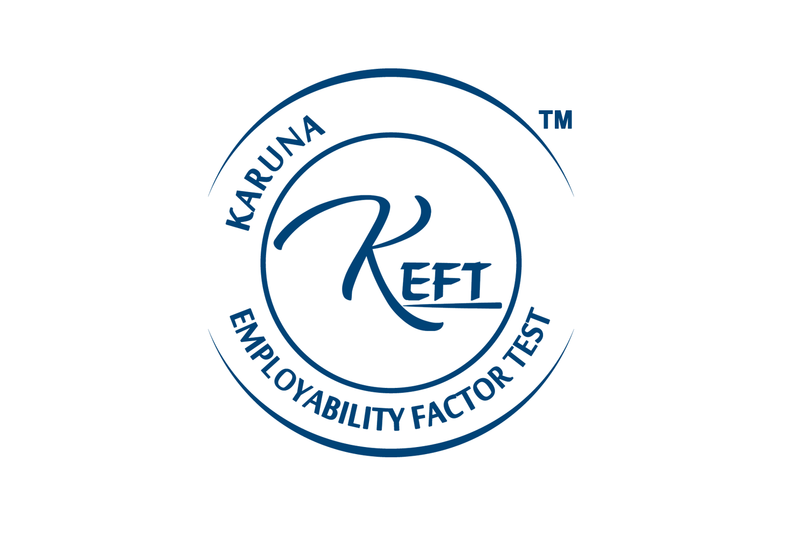

TM
Employment should only be understood as “Application of Knowledge & Skills” of a Person
by Employers “to create Value for Society”.

Slide 46
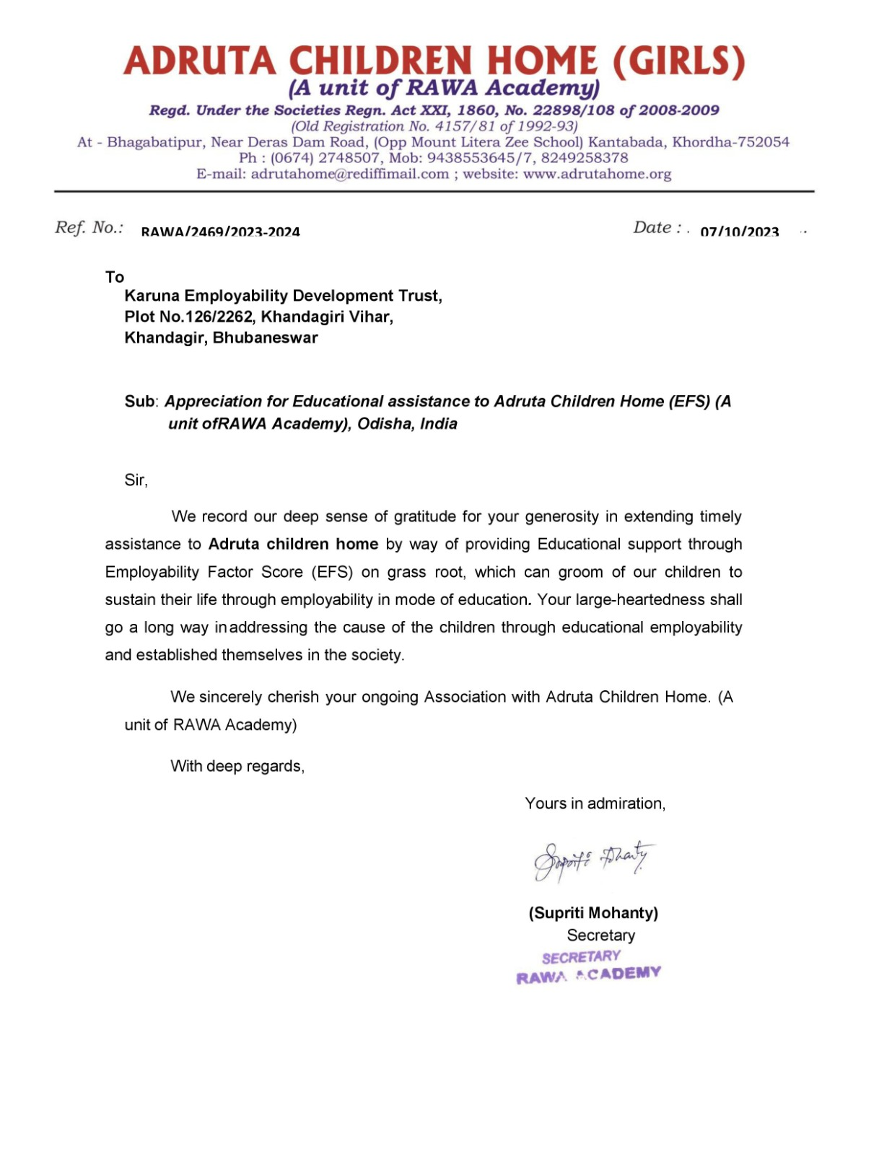
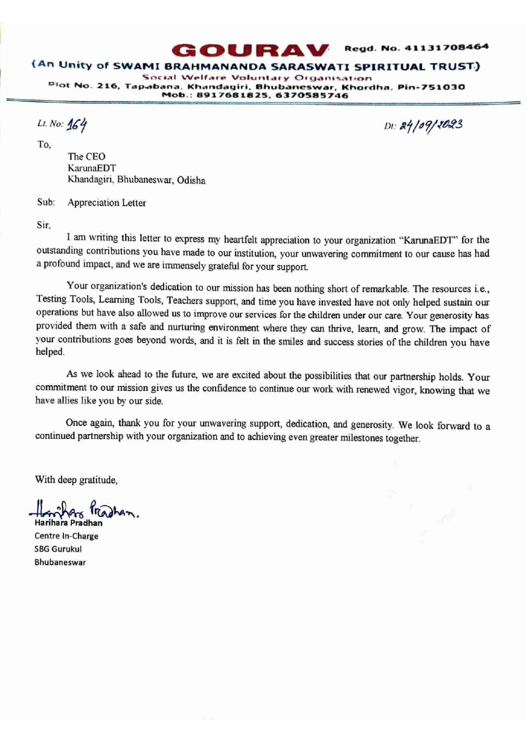
Employment should only be understood as “Application of Knowledge & Skills” of a Person
by Employers “to create Value for Society”.

Slide 47
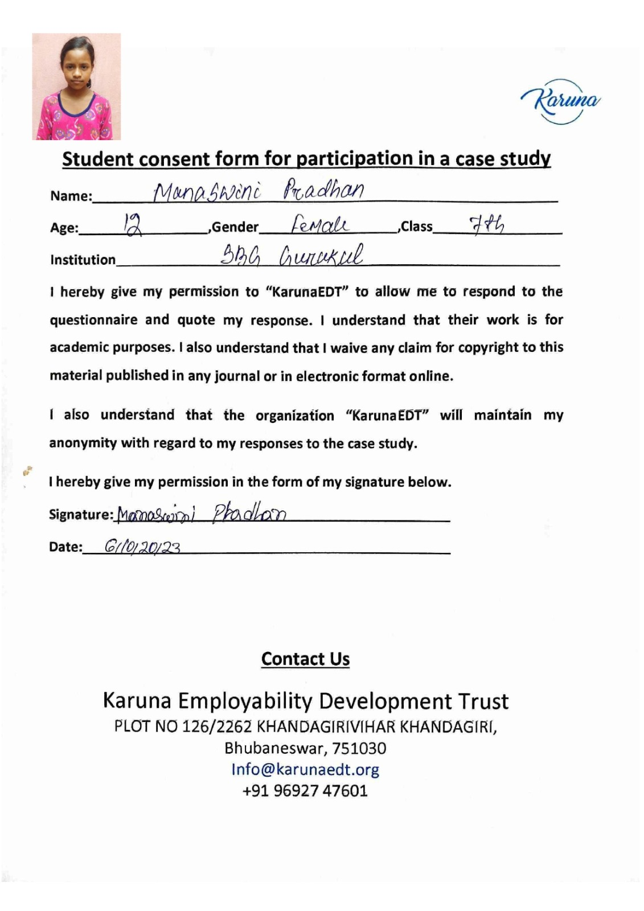

Employment should only be understood as “Application of Knowledge & Skills” of a Person
by Employers “to create Value for Society”.

Slide 48
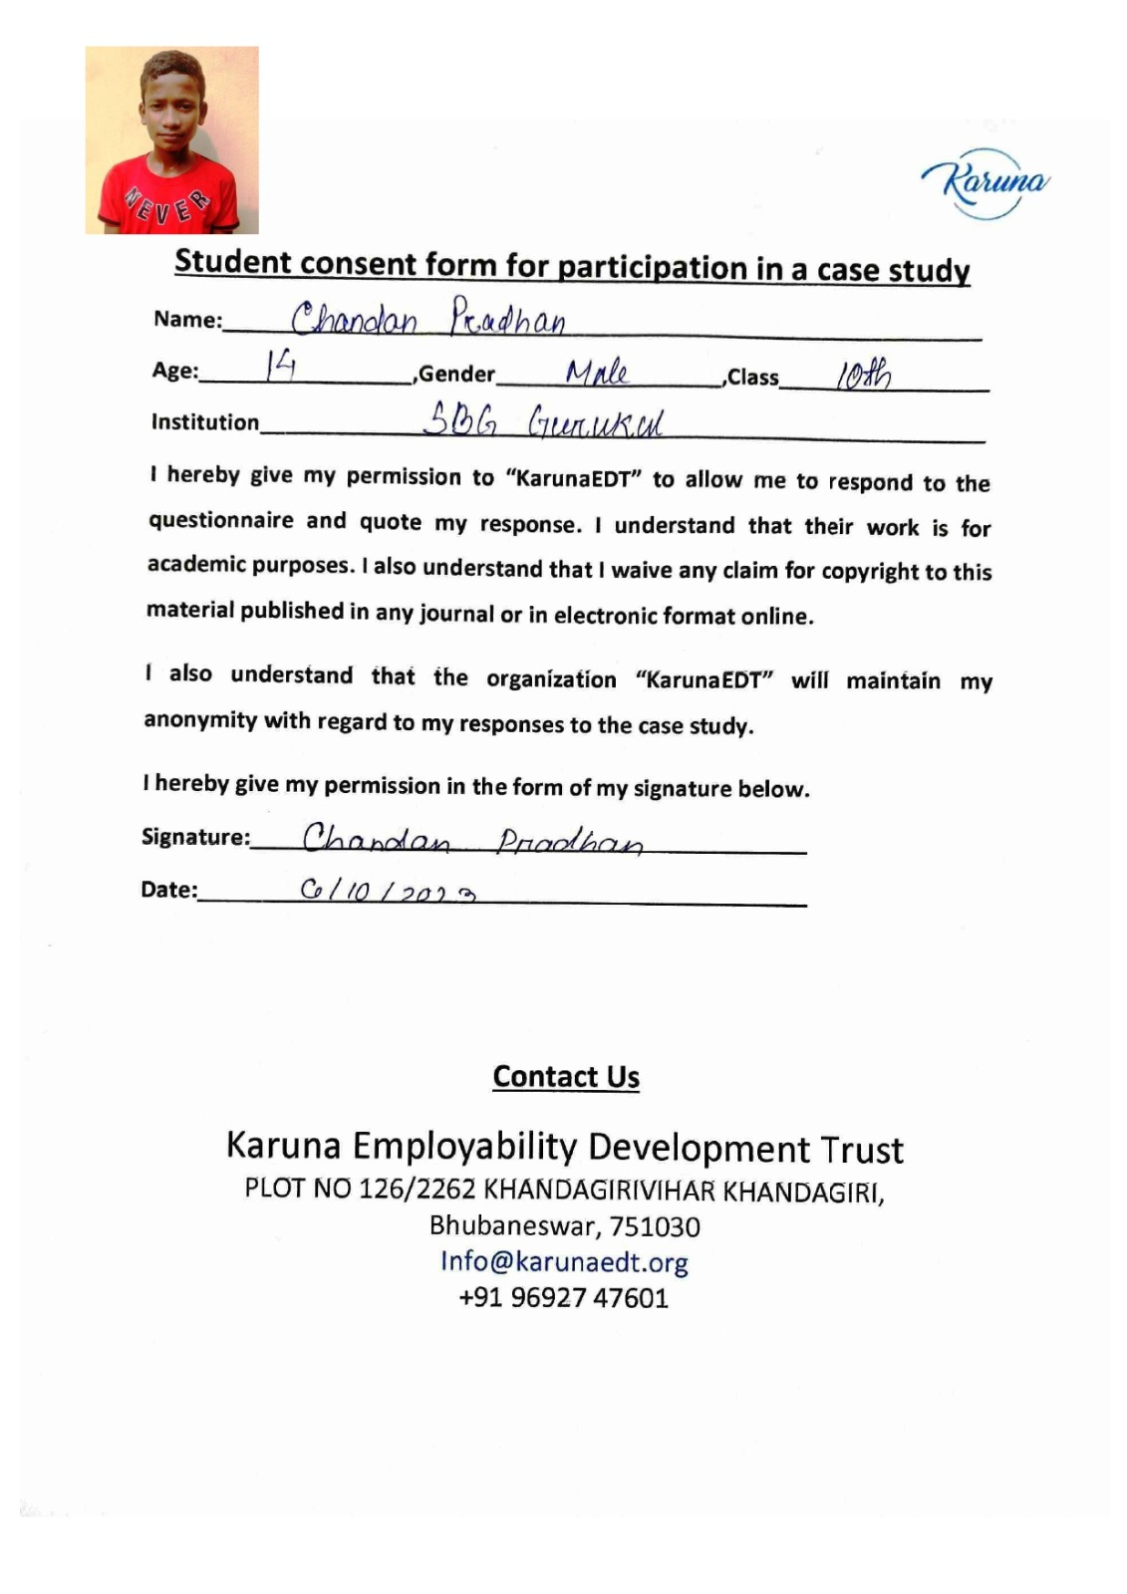
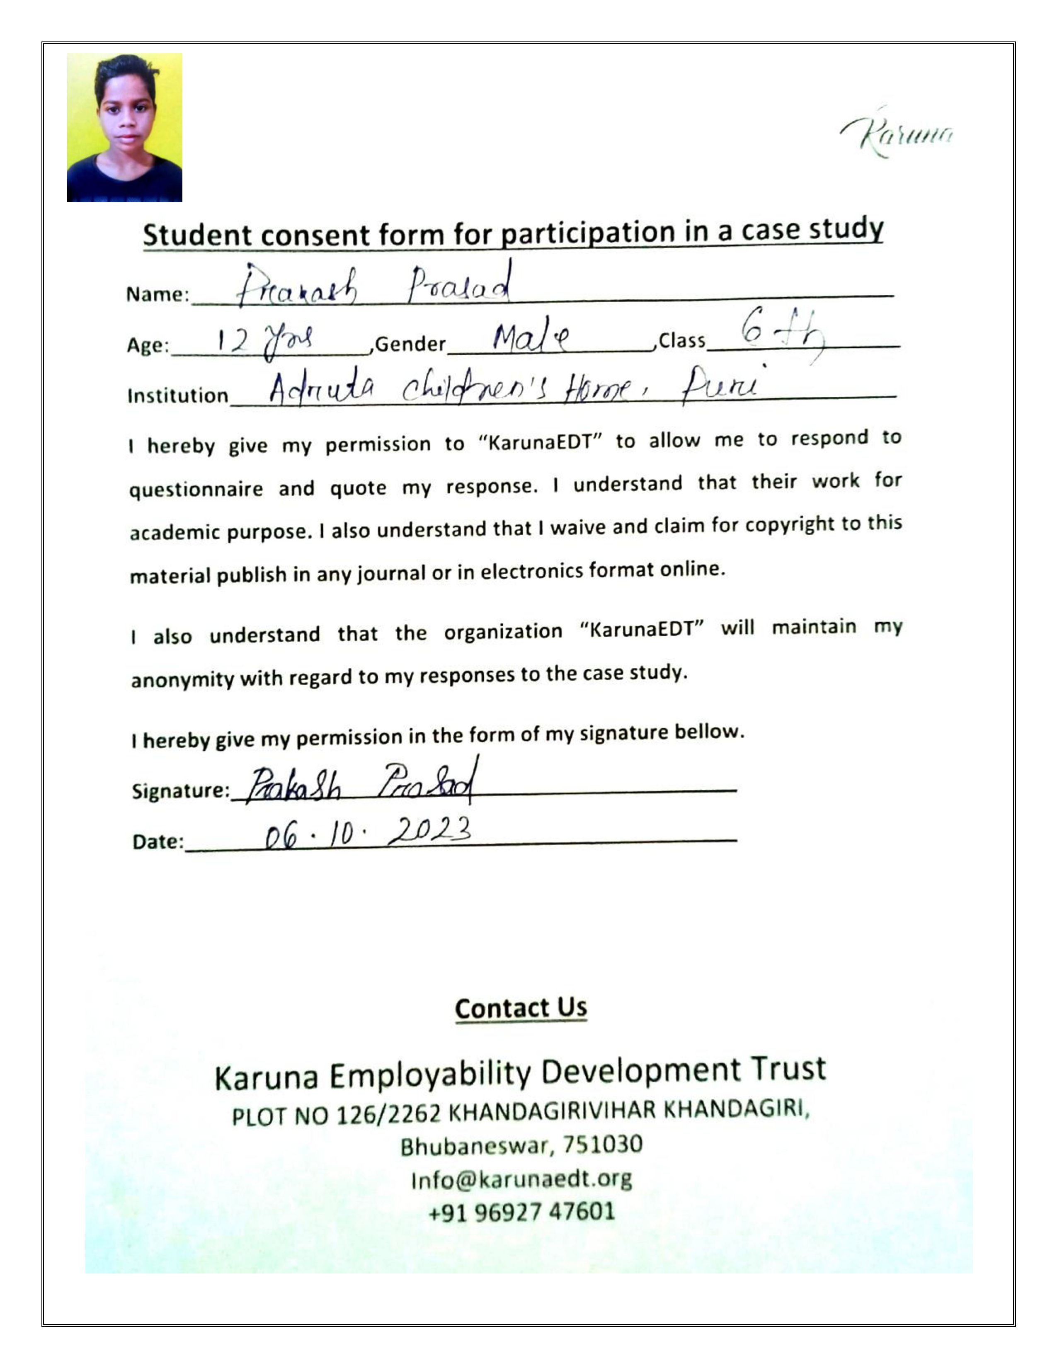
Employment should only be understood as “Application of Knowledge & Skills” of a Person
by Employers “to create Value for Society”.

Slide 49
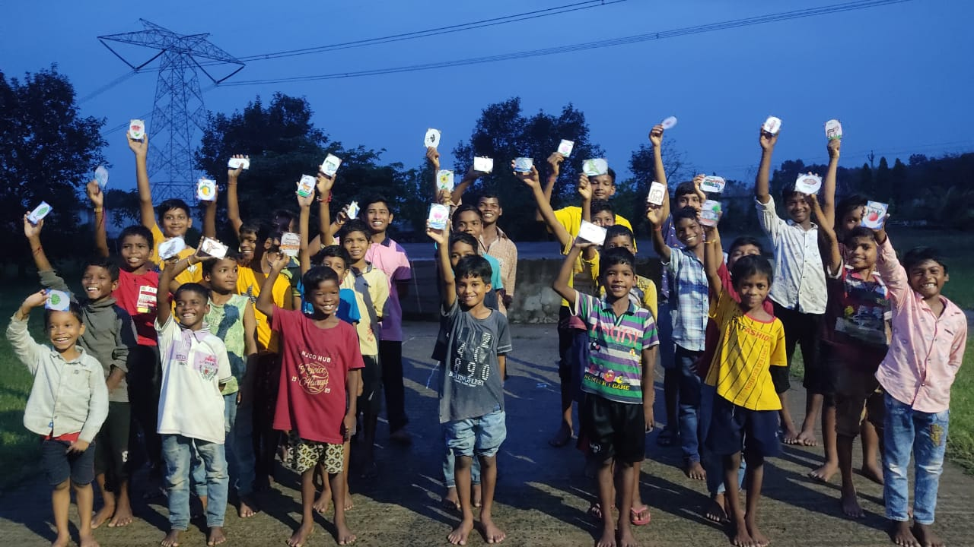
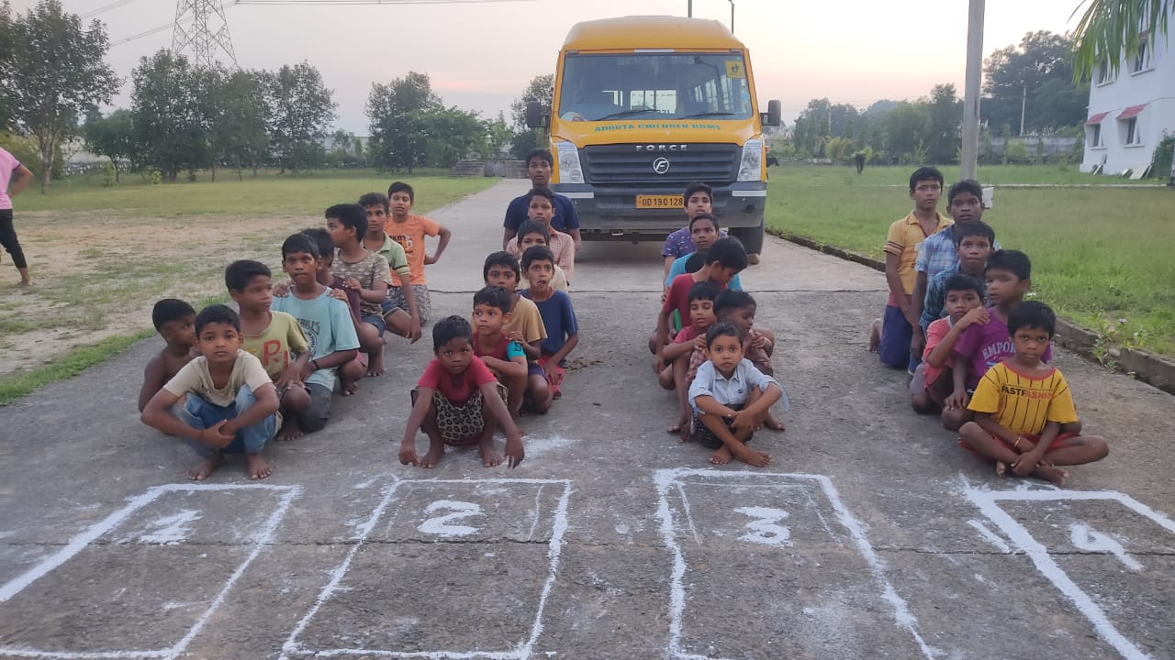

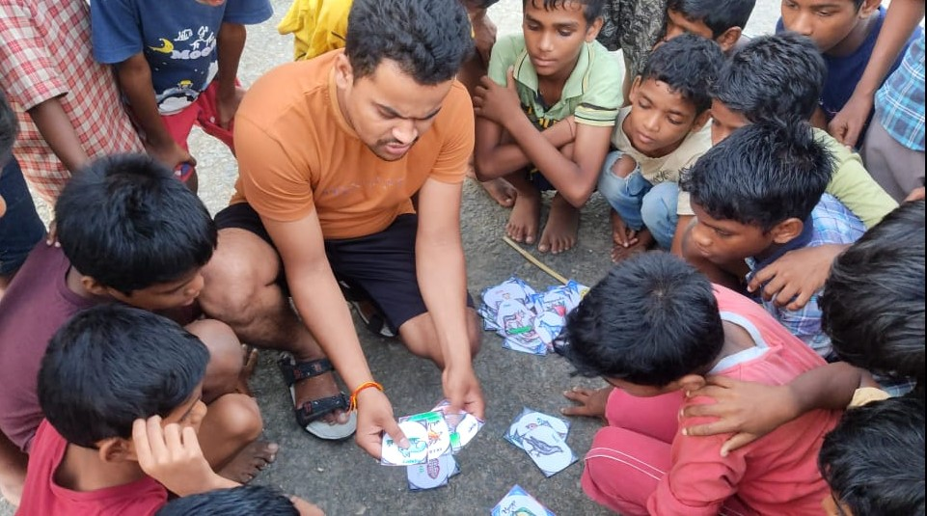
Adruta Children Home- Angul

Slide 50
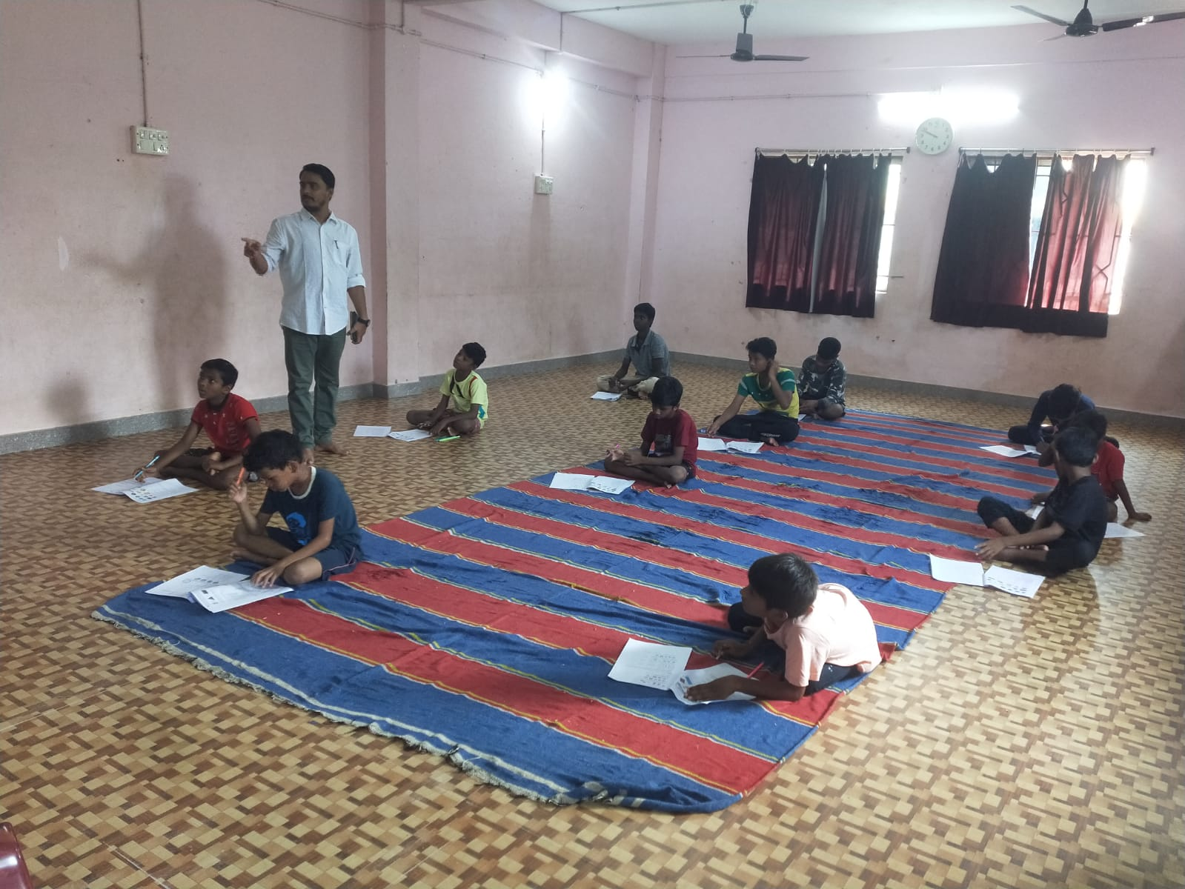
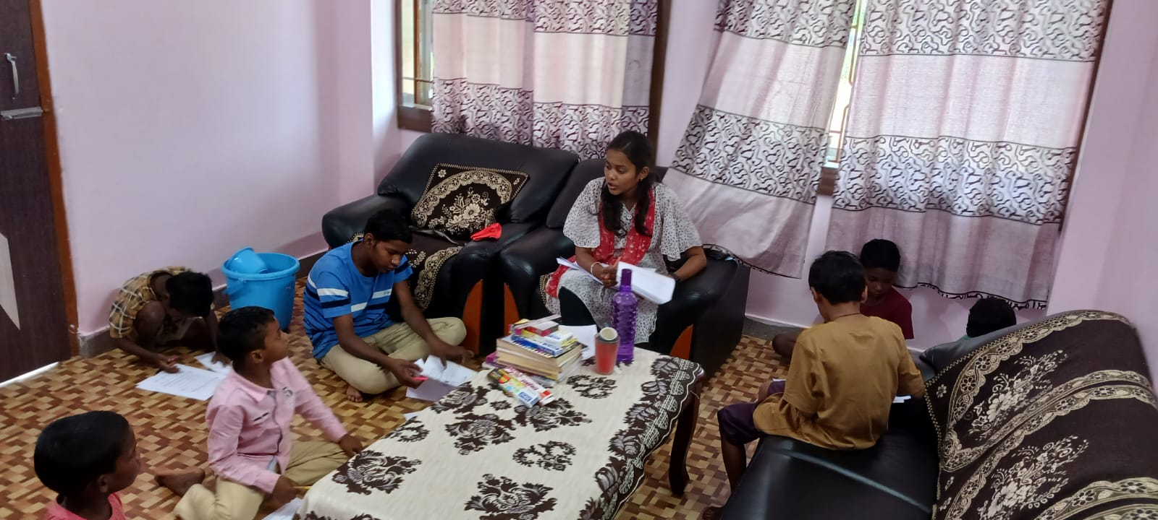
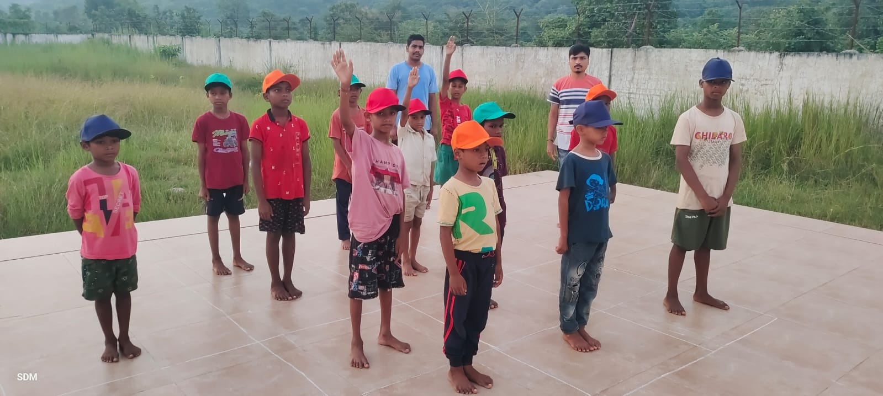
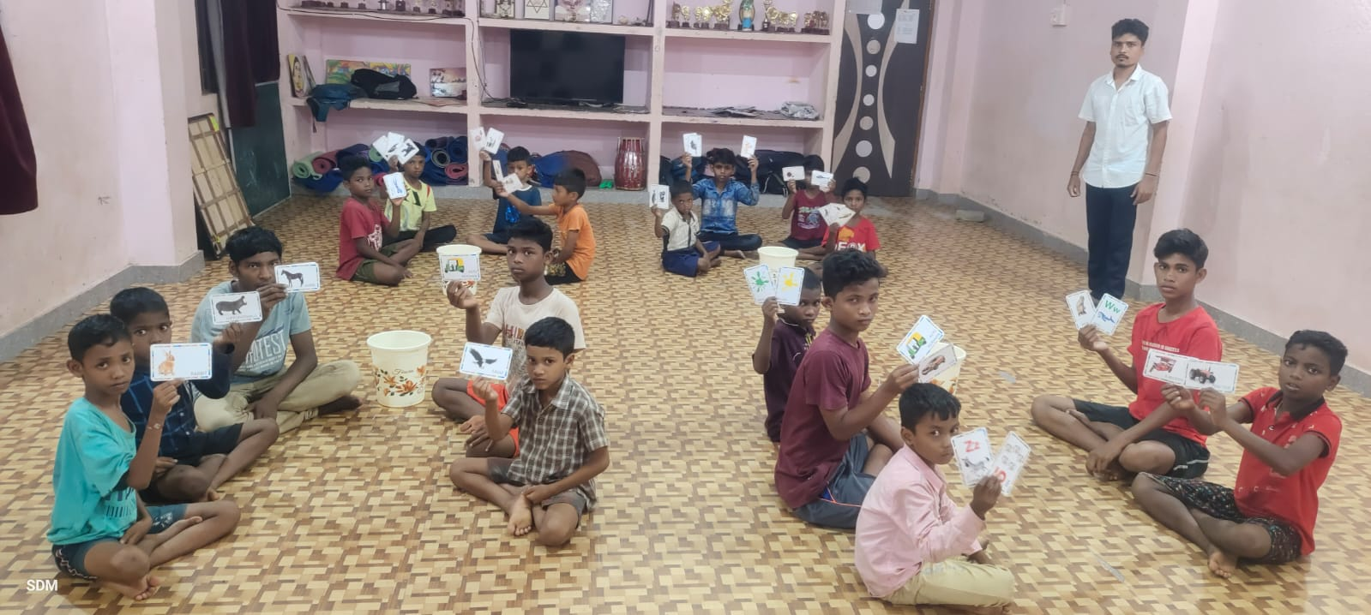
Adruta Children Home- Bolangir

Slide 51

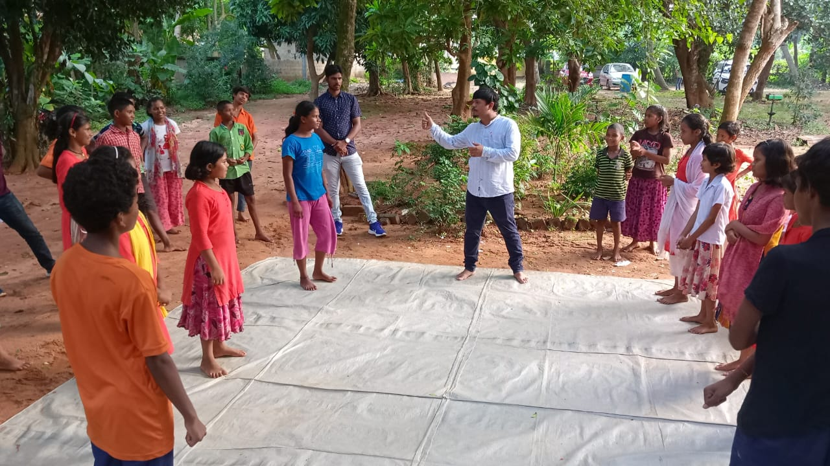
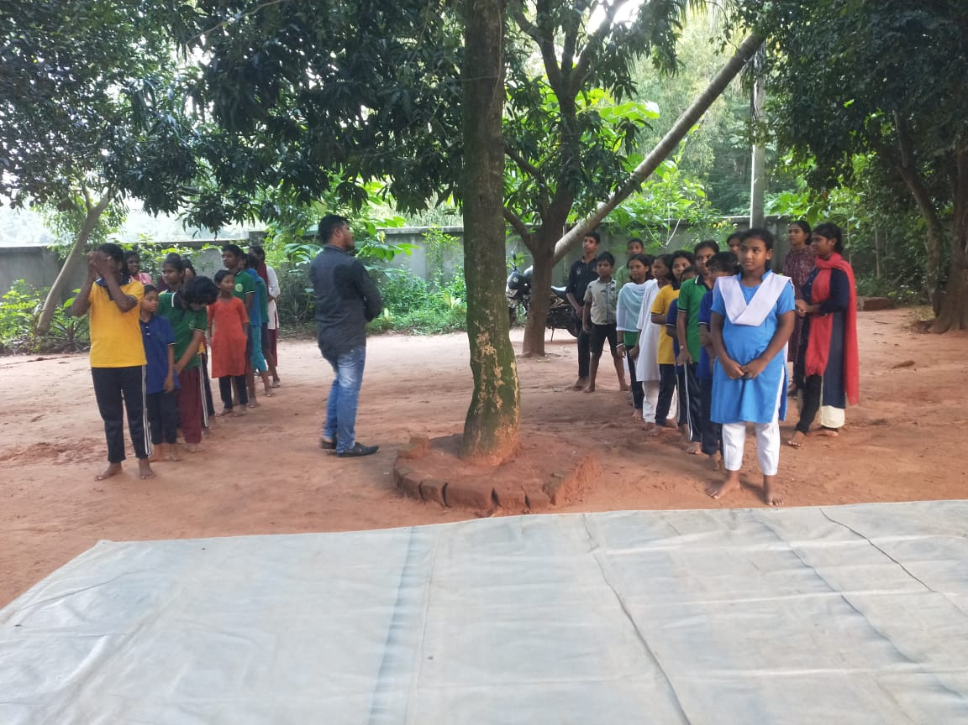
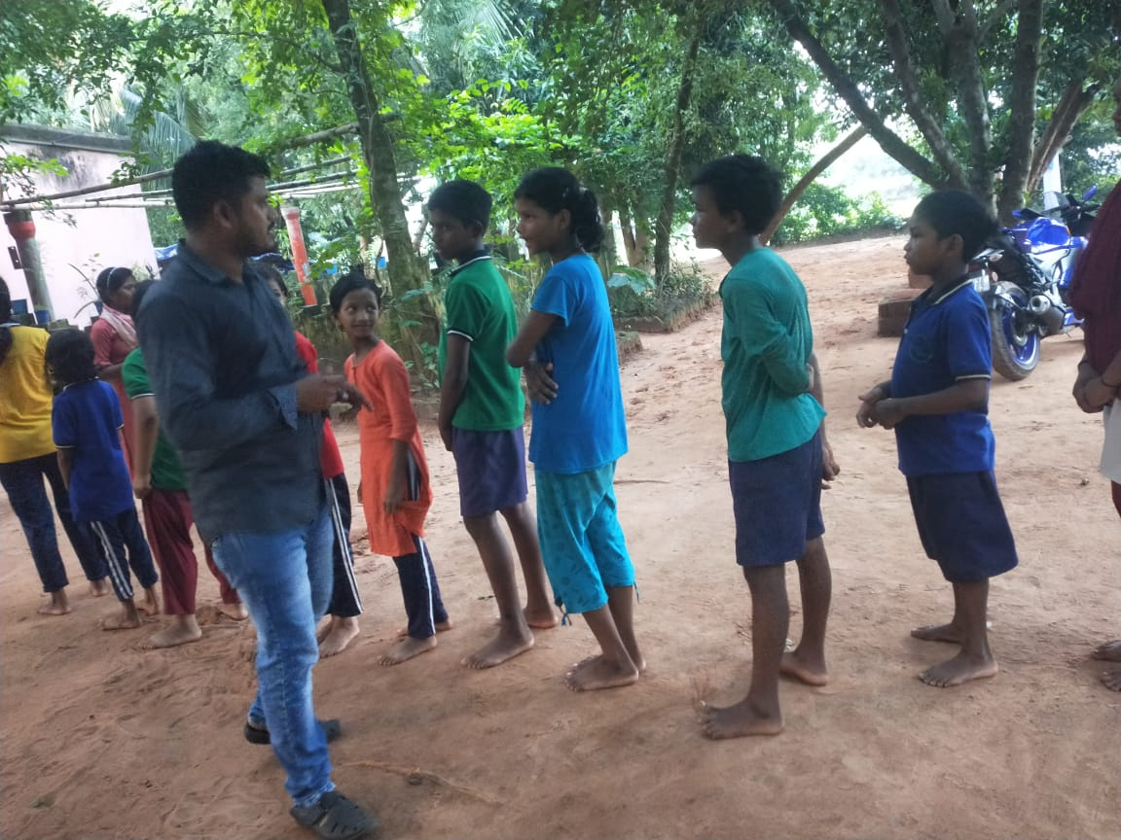
SBG Gurukul & Children Home, Bhubaneswar

Slide 52
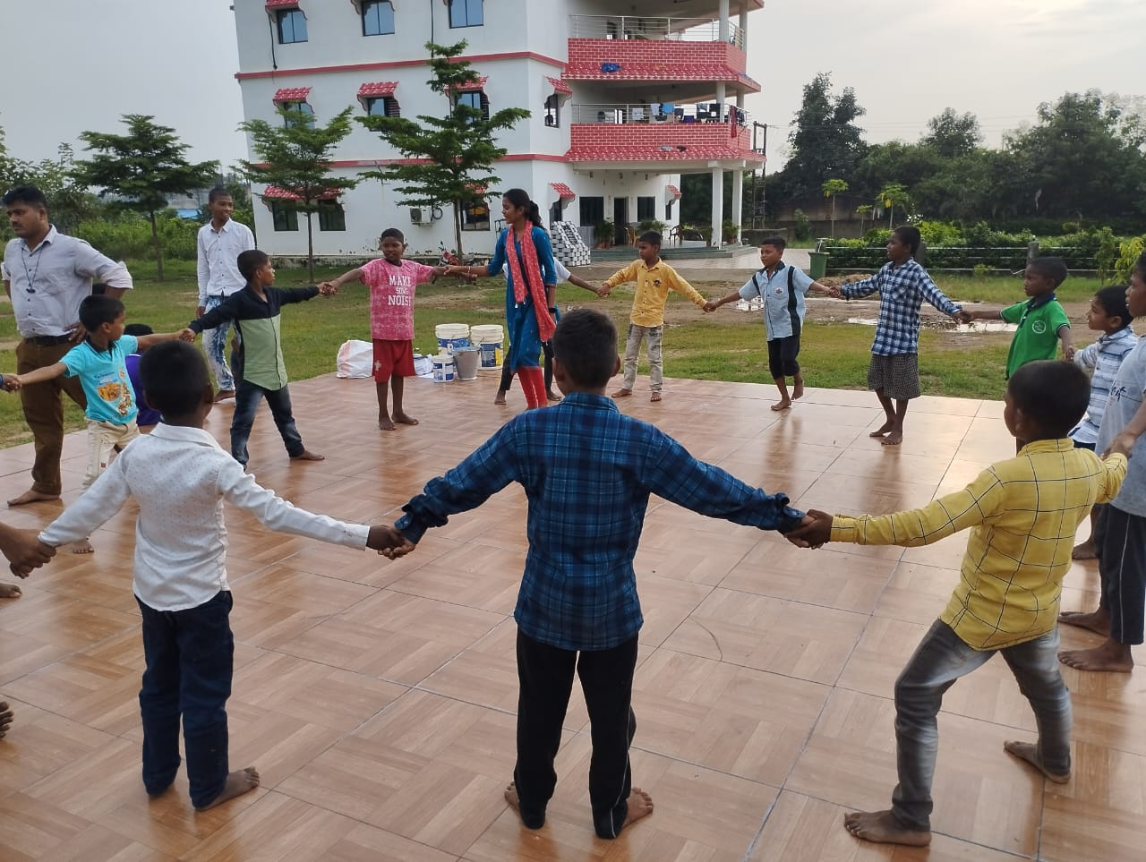
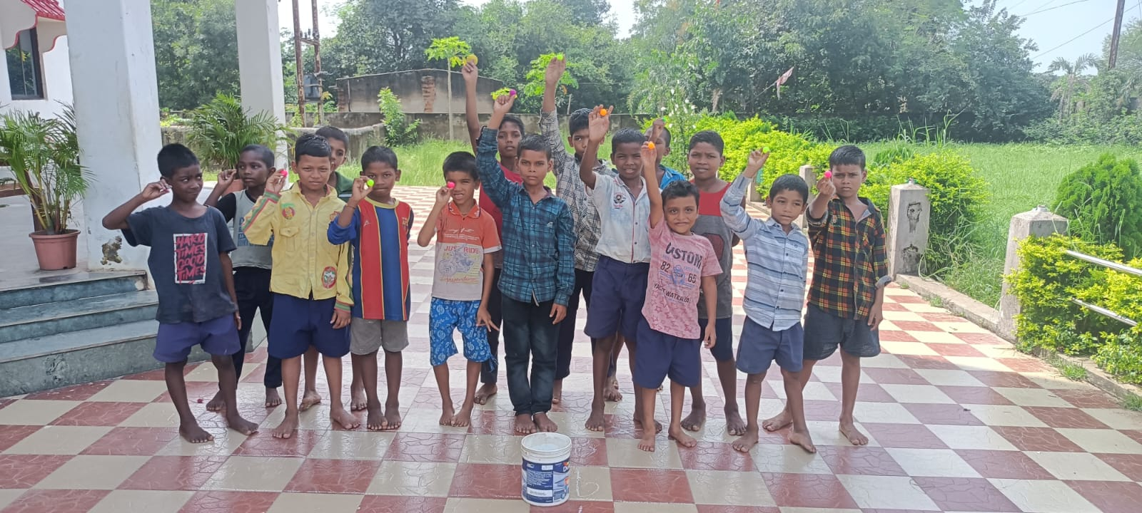
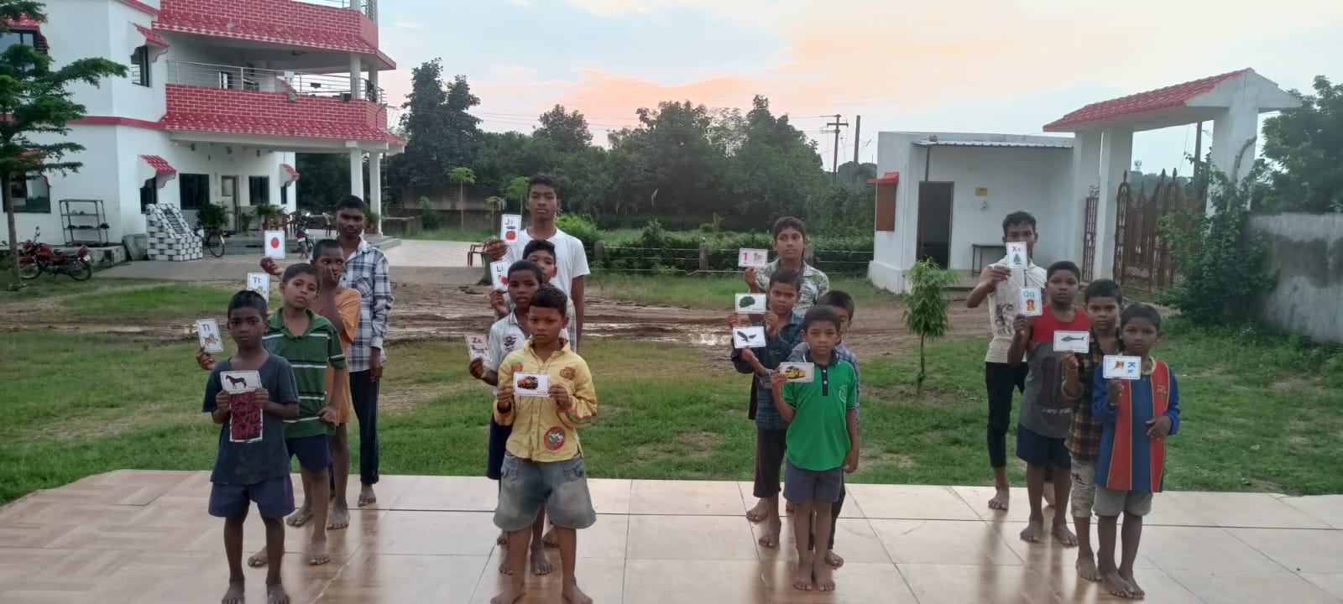
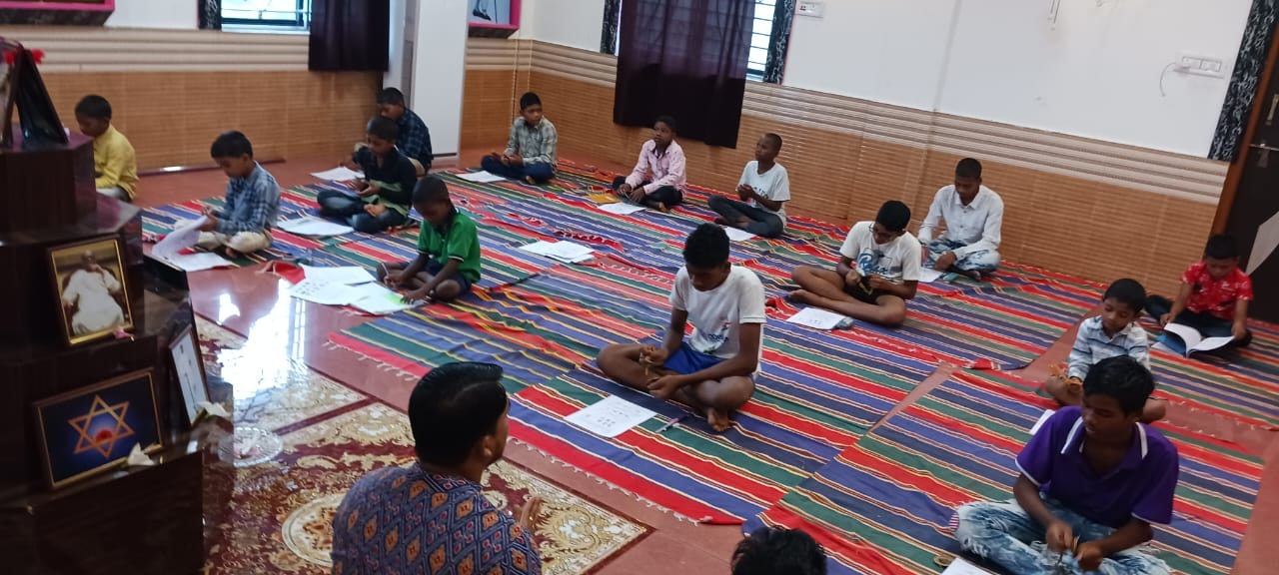
Adruta Children Home- Sundargarh

Slide 53
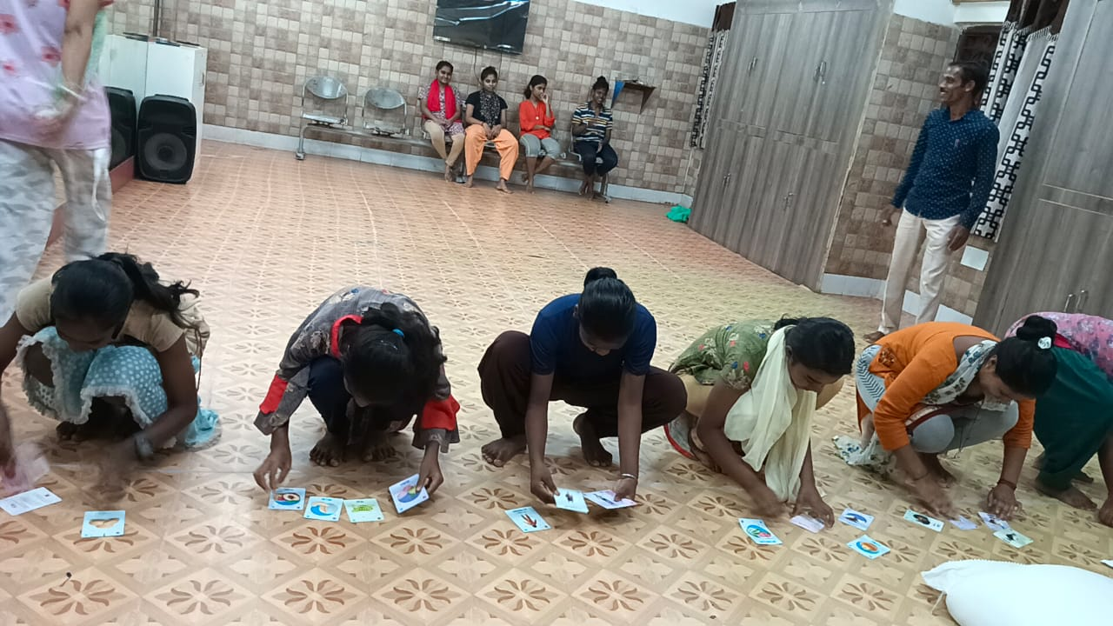

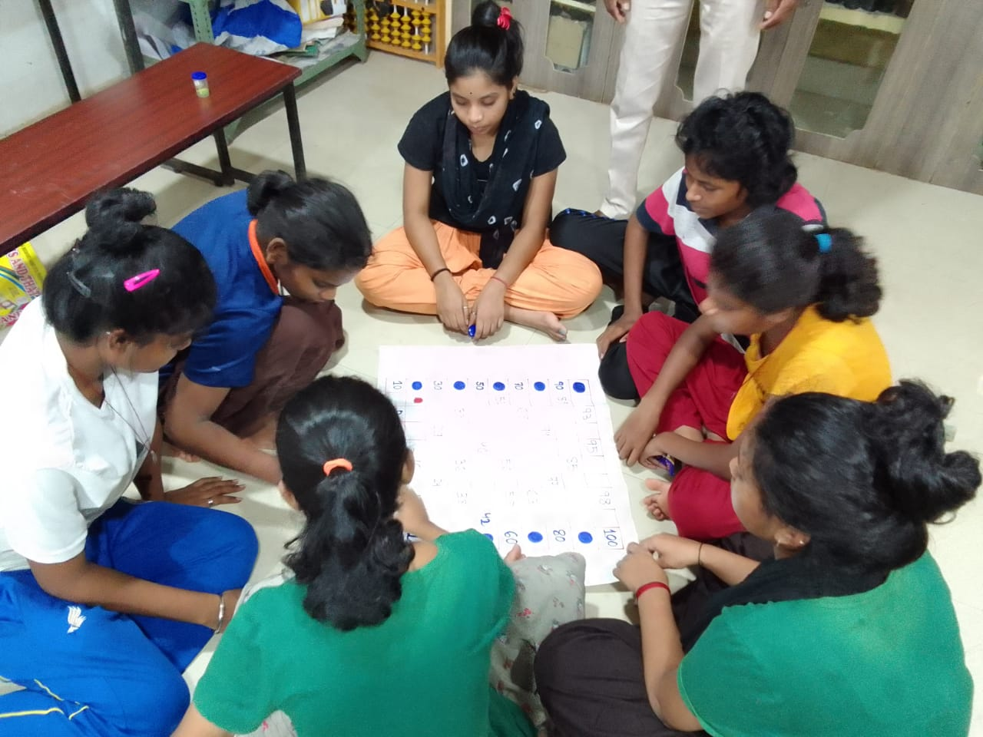
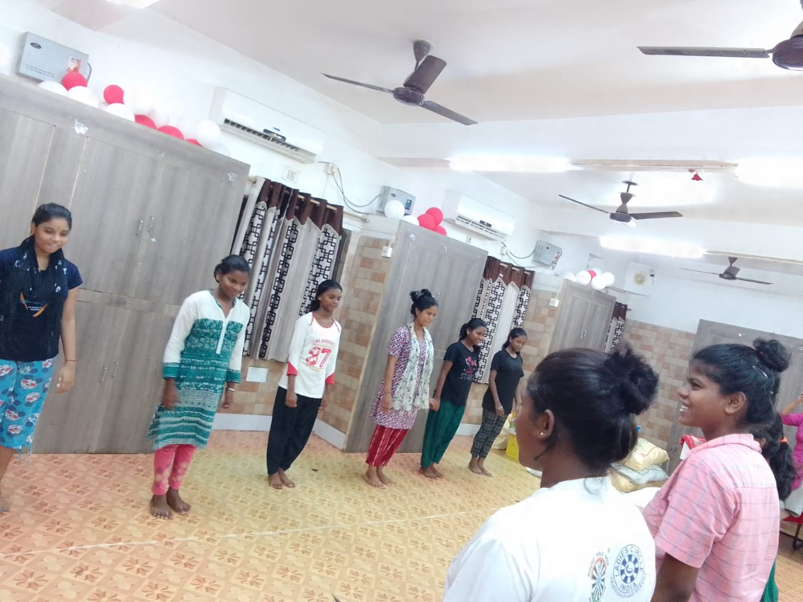
Adruta Children Home (Girls) - Bhubaneswar

Slide 54
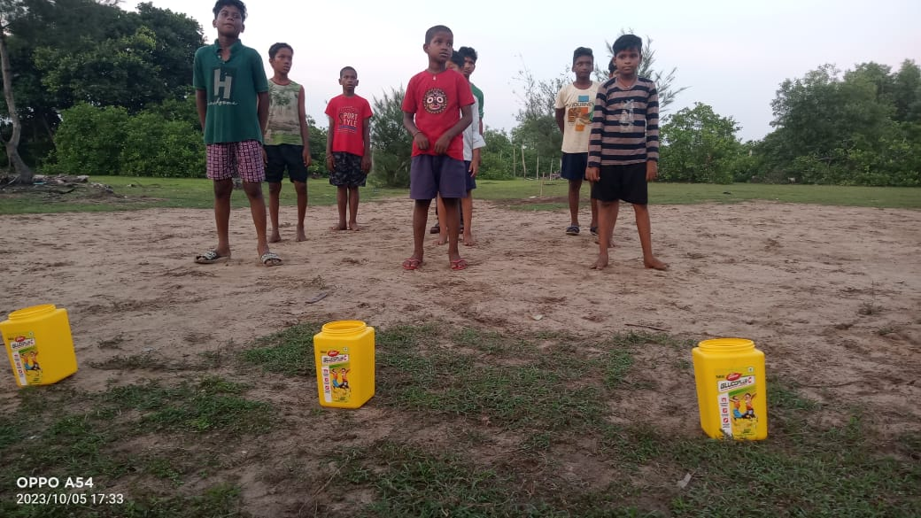
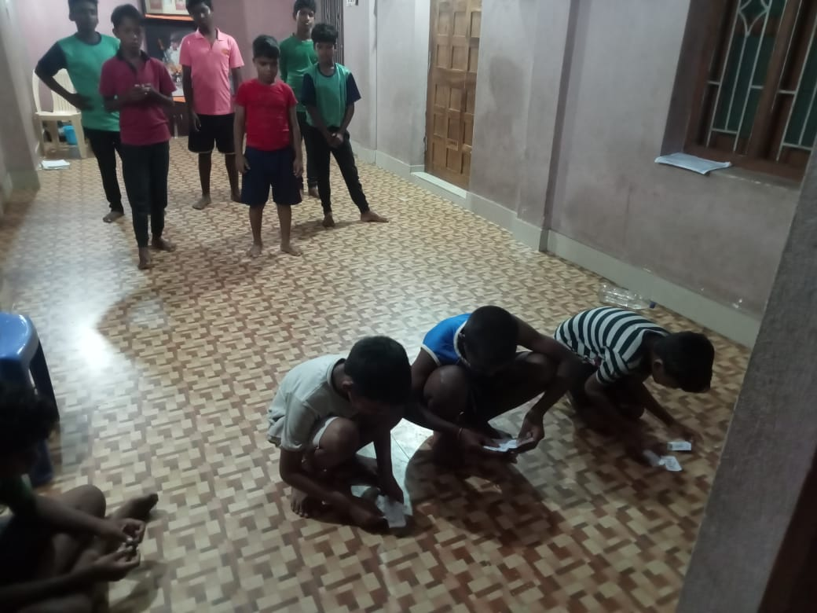
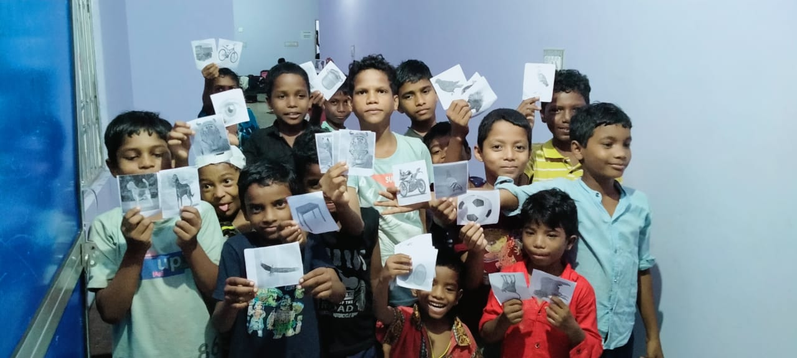

Adruta Children Home- Baripada (Mayurbhanj)

Slide 55

KEDT – PHILOSOPHY
Political Justice can only be attained if both Social Justice and Economic Justice are achieved.
Economic Justice hence Equality, in the true spirit, can only be secured by empowering each citizen of India as a Value Creator in society.
Employment should only be understood as “Application of Knowledge & Skills” of a Person
by Employers “to create Value for Society”.

